Slide 1







CULTURALLY COMPETENT COLLABORATIVE XBA EVALUATIONS
& THE SCIENCE OF READING FRAMEWORK
Andrew Shanock, Ph.D., NCSP
ashanock@yahoo.com
@ashanock
This handout contains key slides from presentation.
Full presentation slides will be made available
andrewshanock

Slide 2
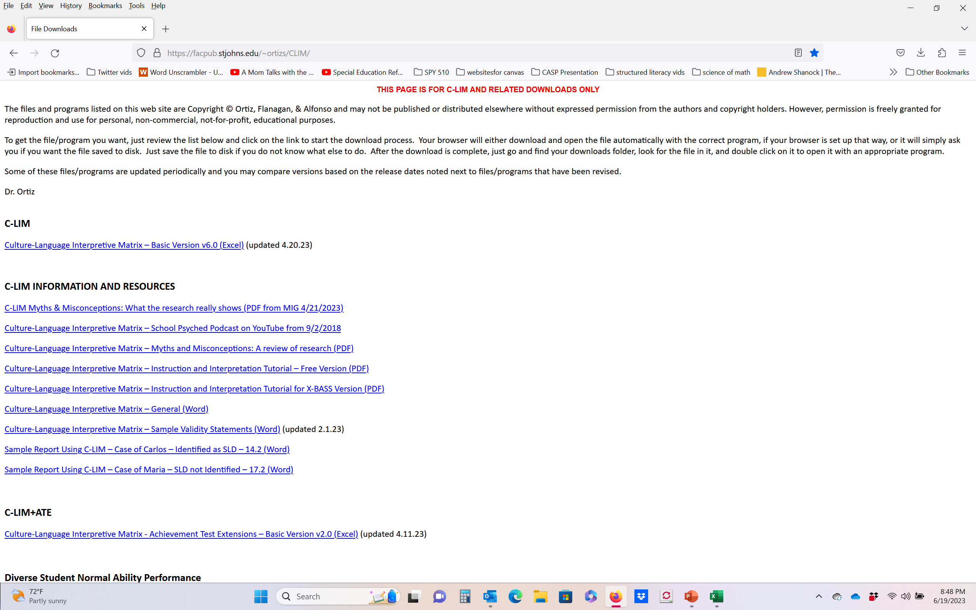
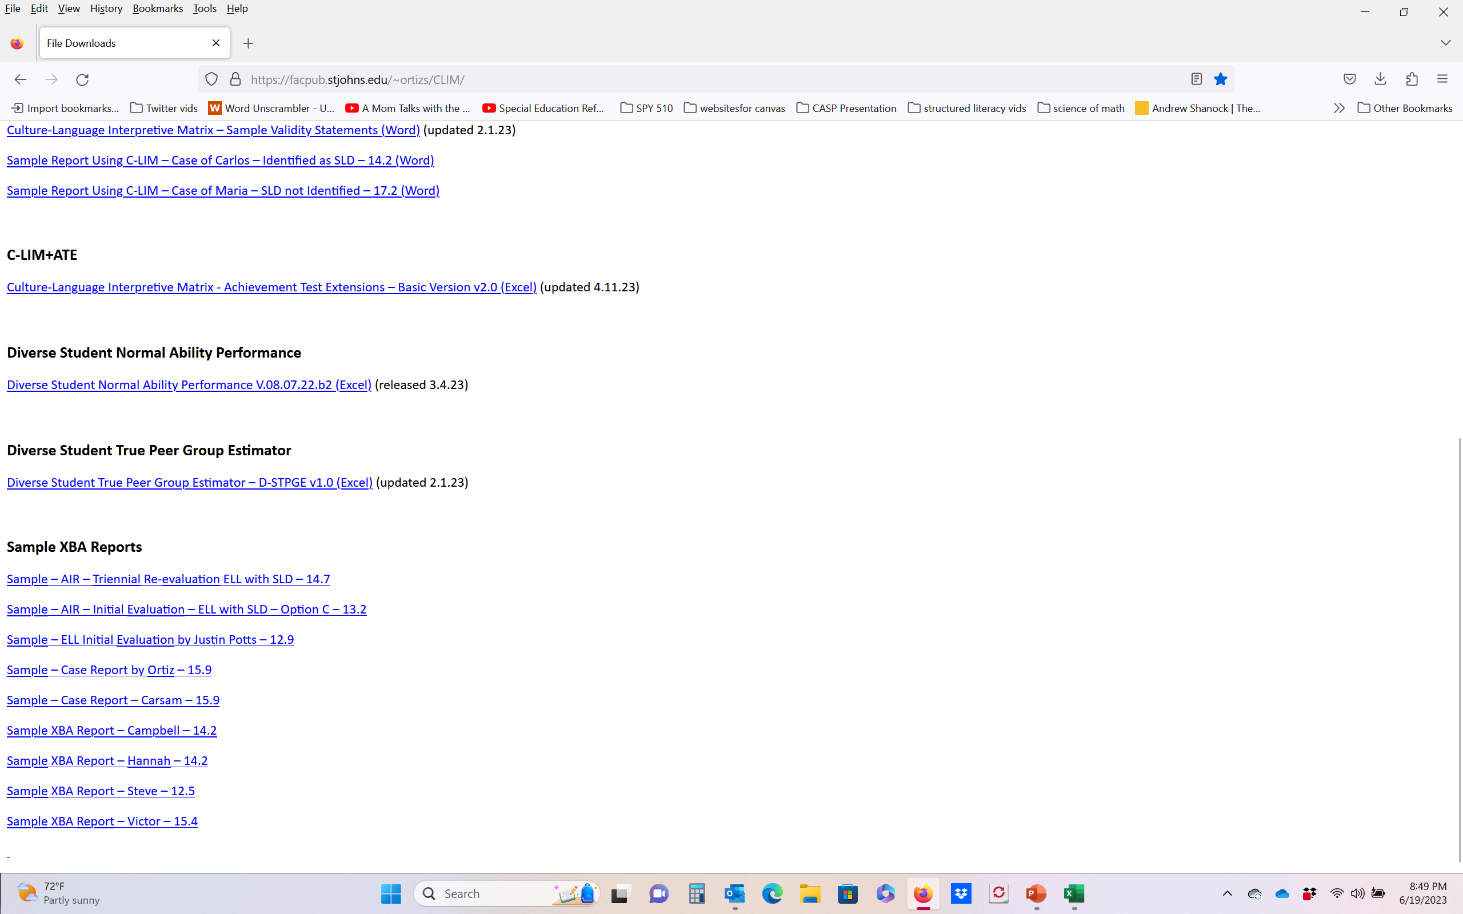
We will be going through some considerations that have to be made about culture and language when doing an assessment. For a deeper understanding, please go to Dr. Sam Ortiz’s website for more information about the CLIM and CLIMATE.
https://facpub.stjohns.edu/~ortizs/CLIM/
Page 4 - handout

Slide 3
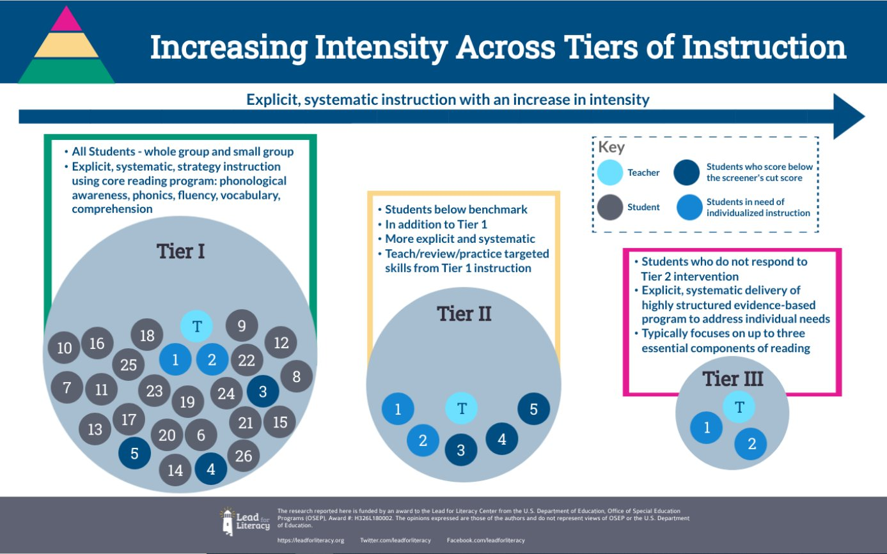
3

Slide 4
4

Slide 5
Simple View of Reading
Decoding
(Word-Level Reading)
Ability to transform print into spoken language
Language Comprehension
Ability to understand spoken language
Decoding X Language Comprehension =
Reading Comprehension
D X LC = Reading Comprehension

Slide 6
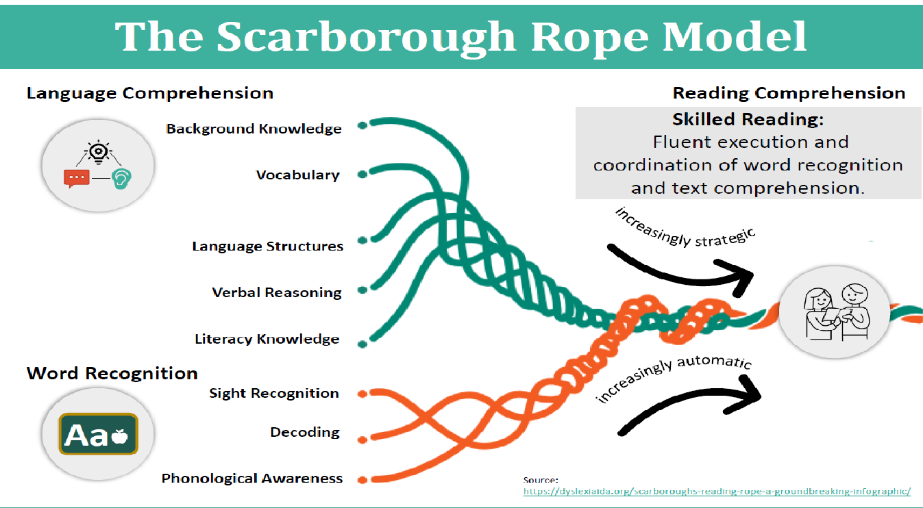
https://www.opportunityculture.org/2019/11/20/the-science-of-reading-introduction/

Slide 7
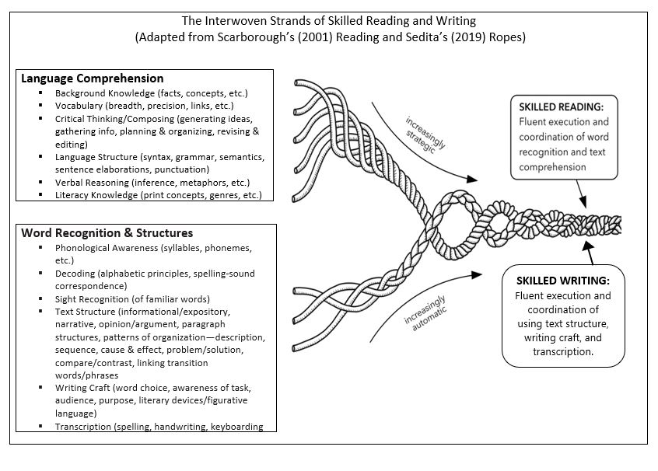

Slide 8
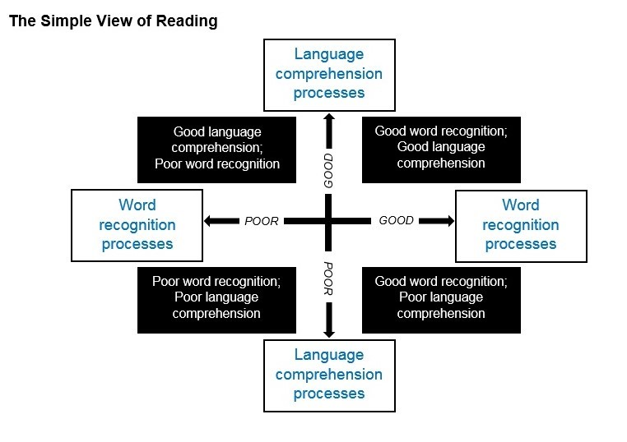
Typical Reader
DYSLEXIA
Mixed
Reading
Disorder
Language
Deficit

Slide 9
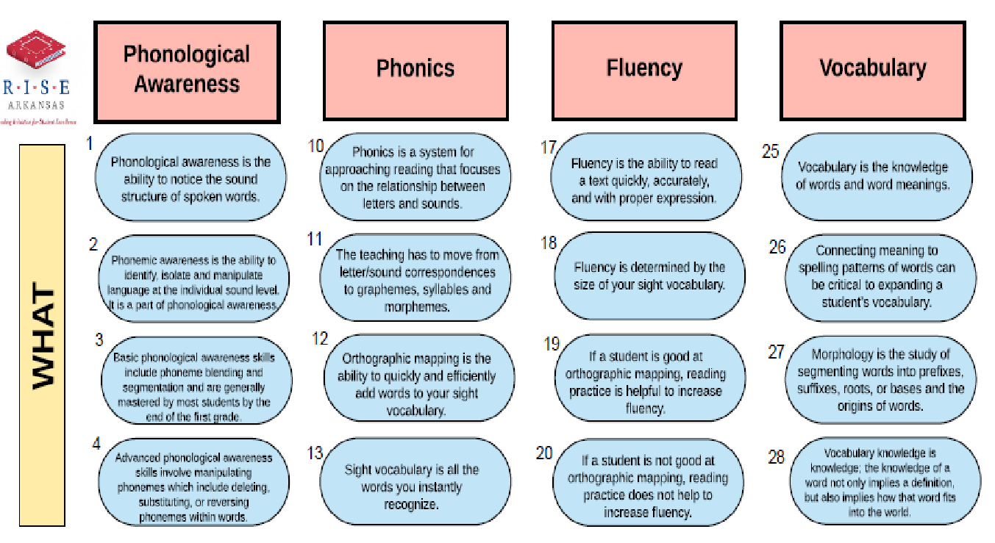
https://sites.google.com/dawsonesc.com/risearkansas/the-big-5

Slide 10
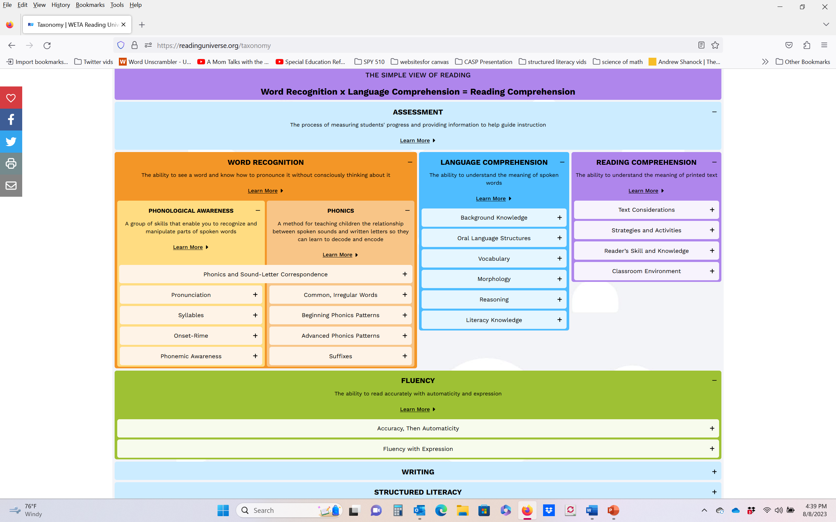
https://readinguniverse.org/taxonomy
10

Slide 11
Ortiz, 2010

Slide 12
LANGUAGE DIFFERENCES VS
LANGUAGE DISABILITIES
Language Area | DIFFERENCE | Possible Disability/ Concerns
SYNTAX Rules governing the order, grammar, and form of phrases or sentences | Grammatical errors due to native language influences. Student omits initial verb in question “You like cake?” omitting the word ‘Do’. Word order in L1 may differ from that of English (subject-verb-object). Arabic – verb-subject-object Urdu – subject-object-verb | Grammatical structure continue to be inappropriate in both languages even after extensive instruction. Student cannot produce past tense in L1 or L2

Slide 13
LANGUAGE DIFFERENCES VS
LANGUAGE DISABILITIES
Language Area | DIFFERENCE | Possible Disability/ Concerns
SEMANTICS Rules pertaining to both the underlying and the surface meaning of phrases | Student may use words from L1 in productions in L2 because of unfamiliarity with L2 vocabulary The car is muy rapido. Student knows the concept as well as the needed structure but cannot remember the vocabulary | Student has limited phrasing and vocabulary in both languages Limited or no use of adjectives and adverbs in both languages

Slide 14
LANGUAGE DIFFERENCES VS
LANGUAGE DISABILITIES
Language Area | DIFFERENCE | Possible Disability/ Concerns
PHONOLOGY Rules for combination of sounds in language | Omits specific sound combinations or have difficulty producing certain sounds in the L2 that do not exist in L1. Trouble producing /r/ /l/ /ch/ /th/ Substituting or adding sounds Tagalog speaker might say ‘past’ instead of ‘fast’ or add a vowel before words “I go to eschool” | Demonstrates a delay in the development of sounds in both languages. Student consistently has trouble producing vowels in both languages

Slide 15
Rich Oral Language Program
Structured Synthetic Phonics
Emphasis on Phonological & Phonemic Awareness
Decodable Reading
Books
Emphasize Blending to Read
Emphasize segmenting to spell
https://fivefromfive.com.au/phonics-and-at-risk-learners/#

Slide 17
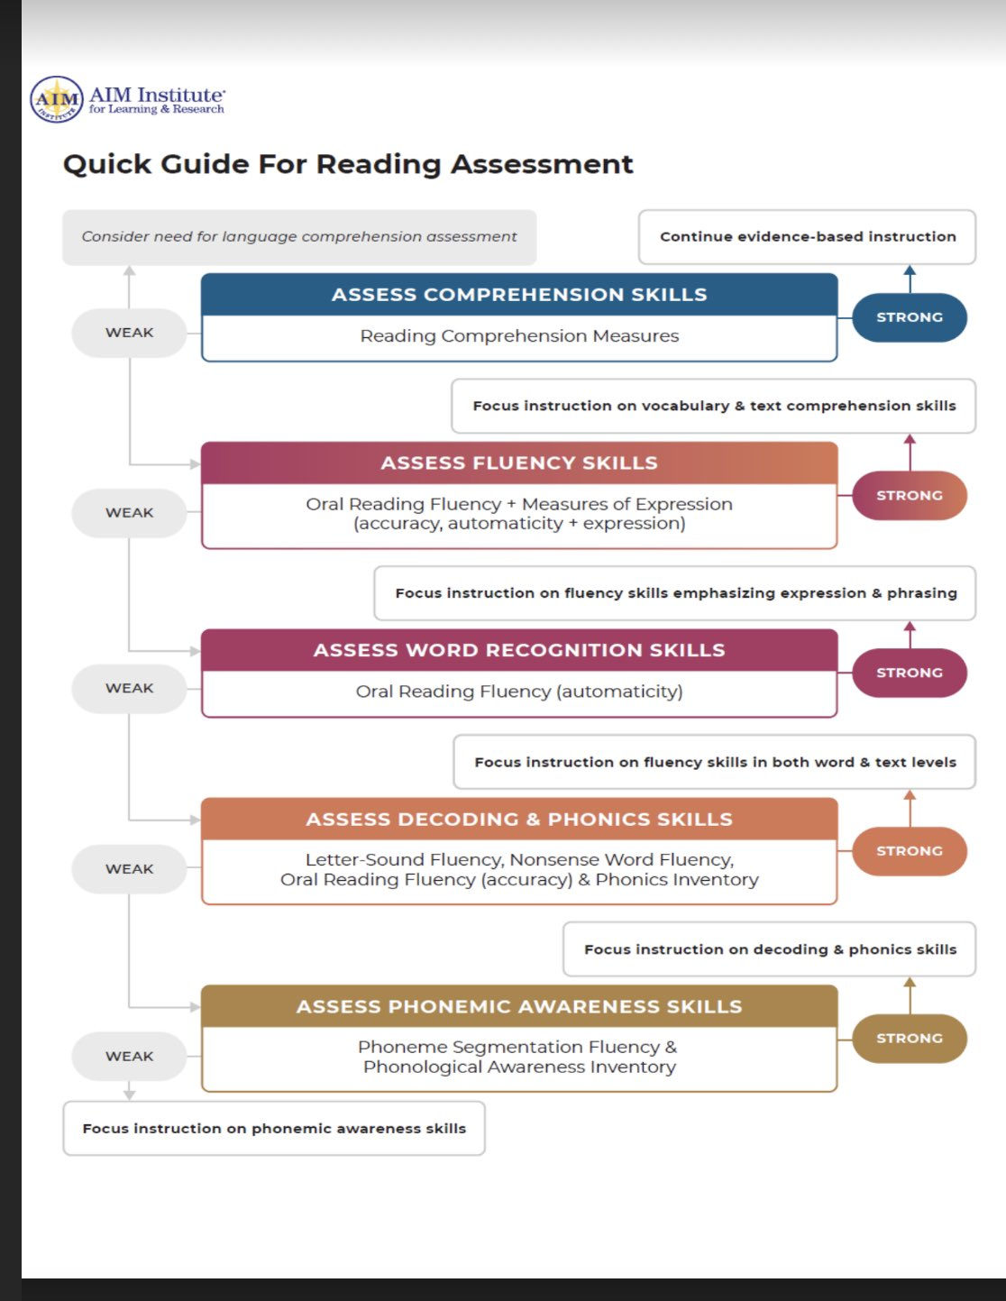

Slide 18
Use the Instructional Hierarchy to Power Your Intervention
Sums to 9
Frustrational
Fluency-Building Intervention: Sums to 18
Sums to 20
Instructional
Goal Skill
Mastery
Frustrational
Fluency-Building Intervention:
Addition with 2-Digit Numbers without regrouping
Acquisition Intervention:
Addition 2-Digit Numbers without regrouping
Addition with 2-Digit Numbers without regrouping
Instructional
Mastery
Fluency-Building Intervention: Addition 2-Digit Numbers with and without regrouping
Addition 2-Digit Numbers,
with and without regrouping
Frustrational
Instructional
Acquisition Intervention: Addition 2-Digit Numbers with and without regrouping
Mastery
Stop
Retool Intensification

Slide 19
AAD | RtI | PSW
Requires a discrepancy between ability and achievement | Requires discrepancies in rate and level of learning | Requires discrepancies between cognitive strengths and cognitive and academic weaknesses
Does not clarify the reason for academic failure despite a consideration of exclusionary factors | Does not clarify the reason for academic failure despite a consideration of exclusionary factors, most notably inadequate instruction and intellectual disability | Clarifies the reason for academic failure as part of a comprehensive evaluation that includes evaluation of exclusionary factors
Unexpected underachievement relative to overall cognitive ability (e.g., FSIQ) | Unexpected underachievement relative to evidence-based instruction and intervention (e.g., Tiers 1 and 2) | Unexpected underachievement relative to the individual’s cognitive capabilities (strengths)
Weaknesses/deficits within the individual (primary) | Weaknesses/deficits within the environment (primary) | Weaknesses/deficits within the individual (primary) and the environment (contributory)
Link to intervention not apparent | Link to intervention based on academic skill deficits only; Limited to no new data to inform intervention after failure to respond | Link to intervention based on academic skill deficits as well as knowledge of how cognitive deficits manifest for the individual in real-world settings (e.g., classroom)
Insufficient information to individualize instruction and intervention | Insufficient information to individualize instruction and intervention beyond Tier 2 and/or Tier 3 | Sufficient information to individualize instruction and intervention (particularly when combined with RtI/MTSS)
Diagnostic errors (false positives and false negatives) are inevitable | Diagnostic errors (false positives and false negatives) are inevitable | Diagnostic errors (false positives and false negatives) are inevitable

Slide 20
General Intelligence (g)
Broad
Quantitative Knowledge (Gq)
Reading & Writing (Grw)
Comprehen Knowledge(Gc)
Fluid Reasoning (Gf))
Working Memory (Gwm)
Learning Efficiency (Gl)
Visual Spatial Processing (Gv)
Auditory Processing (Ga)
Retrieval Fluency (Gr)
Processing Speed (Gs)
Mathematical Knowledge (KM)
Reading Decoding (RD)
General info (K0)
Induction
(I)
Aud Short Term memory (WA)
Associative Memory (MA)
Visualization
(VZ)
Phonic Coding (PC)
Ideational Fluency (FI)
Perceptual Speed (P)
Mathematical Achieve (A3)
Reading Comp
(RC)
Language Develop (LD)
General Seq Reasoning (RG)
Vis Spatial Short Term Mem (Wv)
Meaningful Memory (MM)
Speeded Rotation (SR)
Speech/Sound Discrim (US)
Expressional Fluency (FE)
Percept Speed Search (Ps)
Reading Speed (RS)
Lexical Knowledge (VL)
Quantitative Reasoning (RQ)
Attention Control (AC)
Free Recall Memory (M6)
Imagery
(IM)
Resistance to Aud Distort (UR)
Associational Fluency (FA)
Percept Speed Compare (Pc)
Writing Ability (WA)
Listening Ability (LS)
Working Mem Capacity (Wc)
Flexibility of Closure (CF)
Maint & Judging Rhythm (U8)
Speed of Lexical Access (LA)
Number Facility (N)
Narrow
Spelling Ability (SG)
Communicat Ability (CM)
Closure Speed (CS)
Memory for Sound Patt (UM)
Naming Facility (NA)
Reading Speed (RS)
English Usage (EU)
Grammatical Sensitivity (MY)
Spatial Scanning (SS)
Musical Discrimin (U1)
Word Fluency (FW)
Writing Speed (WS)
Writing Speed (WS)
Length Estimation (LE)
Absolute Pitch (UP)
Sensitivity to Problems (SP)
Intelligence as Knowledge
Percept Illusions (IL)
Sound localization (UL)
Figural Fluency (FF)
Working Memory (Gwm)
Intelligence as a process
Intelligence as process speed/fluency
Figural Flexibility (FX)
Shanock, 2021

Slide 21
3

Slide 22
Summary of Relations between CHC Abilities and Specific Areas of Academic Achievement
(Berninger, 2013; Flanagan and colleagues, 2006, 2013; McGrew & Wendling, 2010; McGrew et al., 2014)
Gwm
Gl-Gr
4

Slide 23
Redundancy
WJ/WESCHLER | TAPS | Time to Administer
Sound Blending | Phonological Blending | 10 min.
Auditory Attention | Word Discrimination | 10 min.
Numbers Reversed | Number Memory Reversed | 5 min.
Memory for Words | Word Memory | 5 min.
Sound Awareness | Phonological Segmentation | 10 min.
Sentence Repetition | Sentence Memory | 5 min.
 | Auditory Comprehension
 | Auditory Reasoning
Digit Span | Numbers Forward | 5 min.
5

Slide 24
Cluster | Test Battery | Subtest Name | Standard Score | Confidence Interval (68%) | Percentile | Classification
Background Knowledge (Gc) |  |  | 109 | 101 to 111 | 65 | Average Range
Breadth and depth of acquired cultural knowledge and its effective application | WISC V | Similarities | 110 | 103 to 117 | 75 | High Average
 | WISC V | Vocabulary | 110 | 103 to 117 | 75 | High Average
 | WJ-IV | General Information | 98 | 91 to 105 | 35 | Average Range
 | CELF-5 | Word Classes | 110 | 103 to 117 | 75 | High Average
 | CELF-5 | Semantic Relationships | 115 | 108 to 122 | 84 | High Average

Slide 25
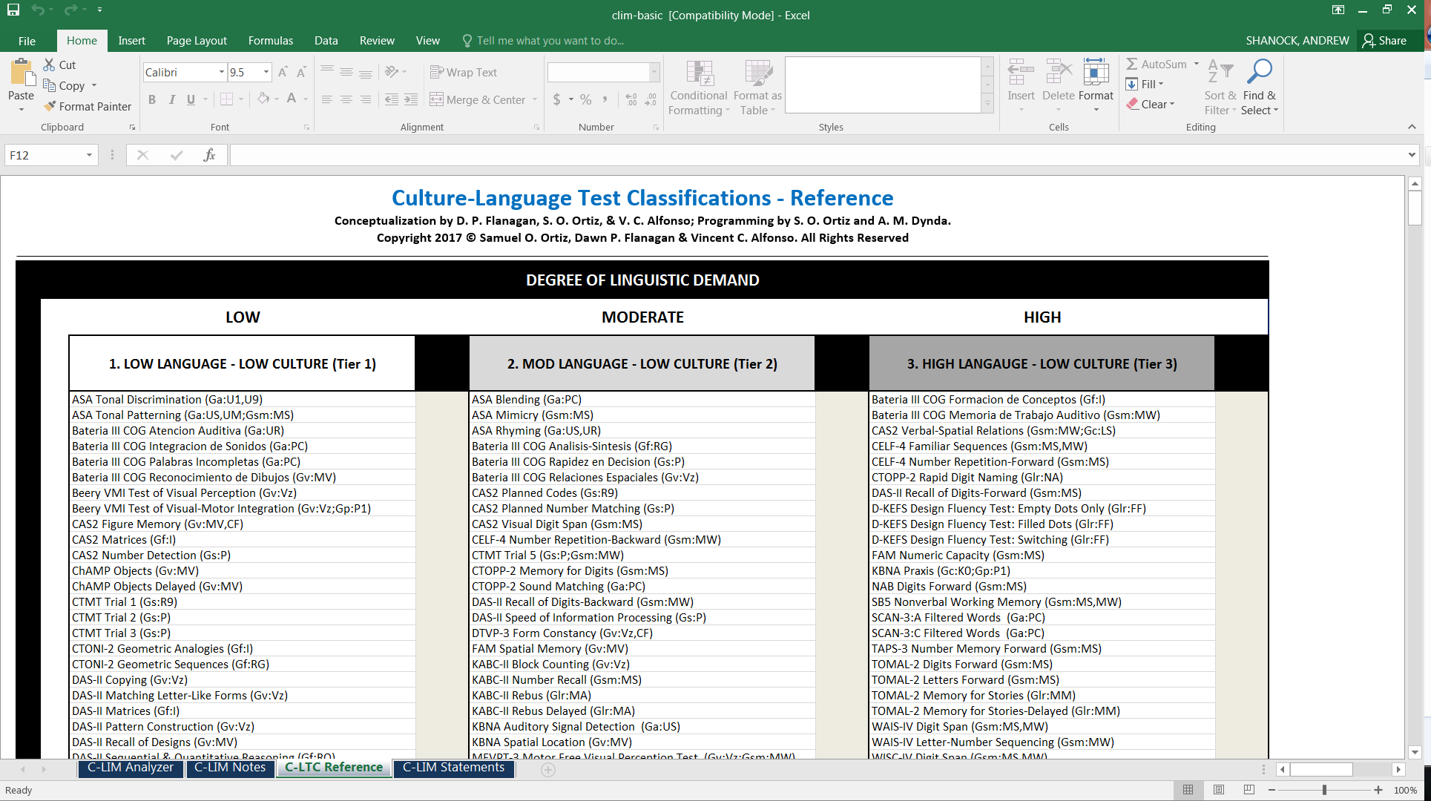
7

Slide 26
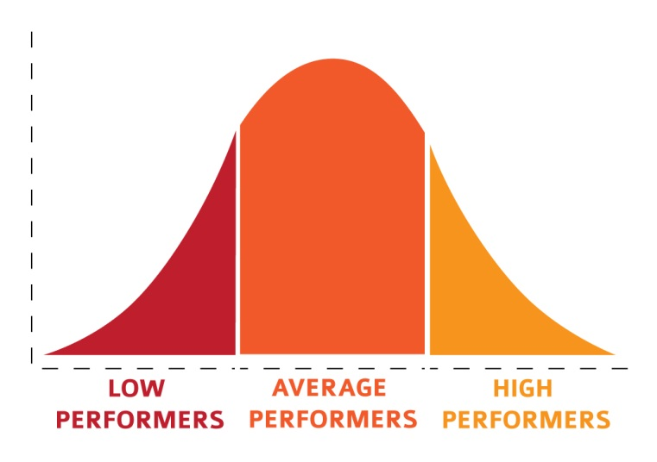
g
learning
retrieve
Vocab
Work memory
Work memory
retrieval
Vocab
reasoning
reasoning
Visual spatial
phonemic
Learning
phonemic
Pattern of Strengths
& Weaknesses (PSW)
speed
speed
Reading

Slide 27
PATTERN OF STRENGTHS AND WEAKNESSES
(PSW)
g
g
Gc
Gv
Gwm
Gl
Gf
Ga
Gr
Facilitating
Composite (FCC)
Inhibiting
Composite (ICC)
Gs
Reading

Slide 28
FCC
ICC
Reading

Slide 29

Abilities and Processes Related to SLD Area: BRS | WISC-V Subtest | Degree of Relationship Based on Literature Review | Example of Supplemental Subtests via XBA if Necessary | Comments
Gc:VL (Lexical Knowledge) | Similarities Vocabulary | Moderate | CELF-5 Word Classes Word Definitions | Similarities may also involve Gf:I CELF-5 is statistically linked to the WISC-V and therefore should be an initial supplemental battery
Gc:K0 (General Information) | Comprehension Information | Moderate | WJ IV COG General Information | In the majority of cases, it will not be necessary to go out of battery for additional K0 subtests
OP (Orthographic Processing) | -- | Moderate | TOC FAR Orthographic Processing Irregular Word Reading Fluency | TOSWRF-2 is also sensitive to OP weaknesses
Gwm: Wa, Wv, Wc, AC (Working Memory) | Picture Span Digit Span Forward Letter-Number Seq. Digit Span Backward Digit Span Sequencing Arithmetic | Moderate | CELF-5 Recalling Sentences WJ IV COG Numbers Reversed Object-Number Sequencing Verbal Attention | Evaluation of difference between auditory and visual memory span will require use of a separate memory battery. Arithmetic also measures math achievement (Gq:A3) and at the older ages may also involve quantitative reasoning (Gf:RQ)
Gl:MA (Associative Memory) | Delayed Symbol Translation Immediate Symbol Translation Recognition Symbol Translation | Moderate | WJ IV COG Visual-Auditory Learning WRAML2 Sound Symbol Sound Symbol Recall | --
Gs:P (Perceptual Speed) Gr:NA (Naming Facility/Speed of Lexical Access) | Symbol Search Cancellation Naming Speed Literacy | Low-Moderate Moderate | WJ IV Number Pattern Matching WJ IV Letter Pattern Matching CTOPP-2 Rapid Digit Naming CTOPP-2 Rapid Number Naming | Other Perceptual Speed tests, such as WJ IV Number Pattern Matching and Letter Pattern Matching are likely more highly related to BRS given emphasis on orthography
Ga:PC (Phonetic Coding) Also referred to as Phonological Awareness | -- | High | KTEA-3 Phonological Processing CTOPP-2 WJ IV OL Segmentation Sound Awareness Sound Blending | KTEA-3 is statistically linked to the WISC-V and, therefore, should be an initial supplemental battery
Ga:UM (Memory for Sound Patterns) | -- | Low-Moderate | CTOPP-2 Nonword Repetition (also Gsm:MS) | Also called Phonological Memory
 | --

Slide 31
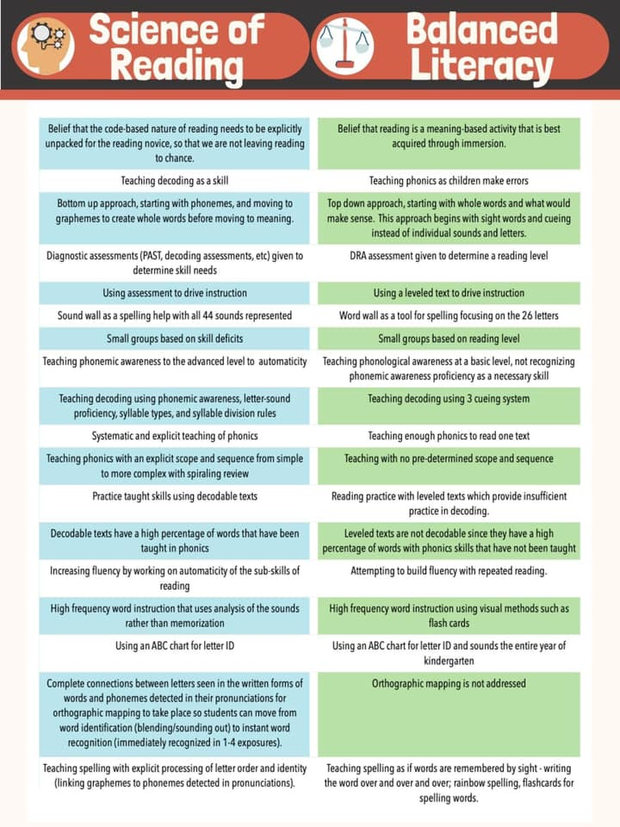

Slide 32
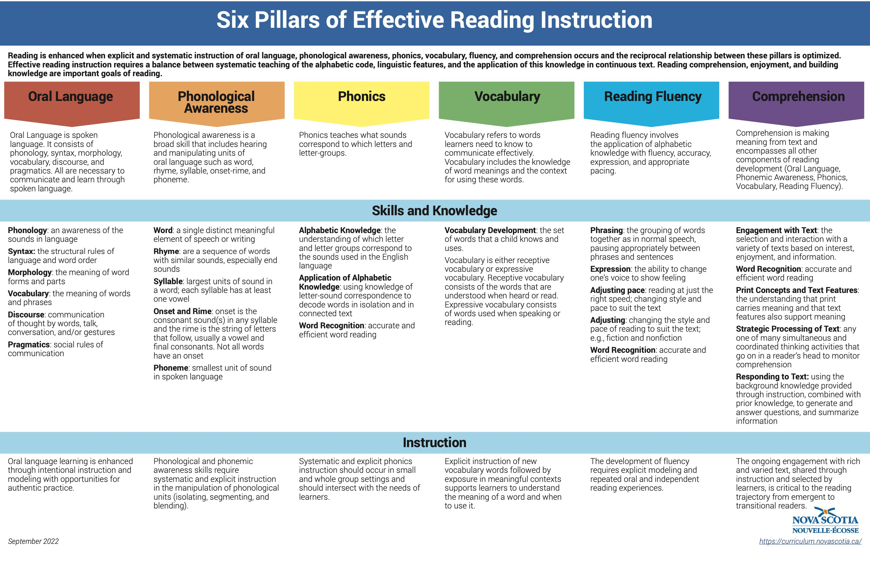
Reports can address each

Slide 33

Oral Vocabulary
May be a case of dyslexia
Reading Comprehension
(cloze, maze, Q/A, timed)
WIAT Receptive Voc- 99
WIAT Expressive Voc- 95
DIBELS Maze intensive/at risk
(Timed CBM 2/1/24)
Oral Language
ORAL LANGUAGE COMPREHENSION
WIAT Oral Discourse - 105
ORF Accuracy
DIBELS 88% intensive/at risk
(2/1/24)
WIAT Reading Comp – 88
(untimed)
Other Oral Language
CELF Recep Lang Index- 101
DIBELS 86% intensive/at risk
(1/15/24)
ORF Rate
DIBELS 66wcpm intensive/at risk
(2/1/24)
Real Word-Accuracy
Observations
WIAT Word Reading - 78
DIBELS 72wcpm intensive/at risk
(1/15/24)
Comprehension issues seem to
be due to inaccurate decoding
Nonsense Word-Accuracy
WIAT Pseudoword Rd- 82
Silent Reading Fluency
WORD READING
Word Read- Automaticity
On WIAT, repeatedly searched
text for answers, took long
time to respond
WIAT Orthograph Fluency- 74
WIAT Decoding Fluency- 83
Phonologic Awareness
CTOPP PA Composite - 82

Slide 34
Oral Vocabulary
Language difficulty
Reading Comprehension
(cloze, maze, Q/A, timed)
PPVT Receptive - 80
WJ Picture Voc 77
GORT Comprehension SS of 5
(Timed & Q/A)
Oral Language
ORAL LANGUAGE COMPREHENSION
WJ Oral Comprehension – 85
(CLOZE)
ORF Accuracy
GORT Accuracy – SS of 8
WJ Passage Comp – 75
(Untimed/Cloze)
Other Oral Language
TOLD Spoken Language– 75
ORF Rate
GORT – SS of 9
Real Word-Accuracy
Observations
WJ IV Word ID - 95
Nonsense Word-Accuracy
GORT Comp – seemed to
read fluently and could
read all words
WJ IV Word Attack- 92
Silent Reading Fluency
WORD READING
Word Read- Automaticity
WJ Sentence Rd Fluency - 84
TOWRE Sight Wrd Efficiency-95
TOWRE Phonetic Decode -97
Phonologic Awareness
CTOPP PA Composite - 101

