Slide 1
Session Attendance QR Code
FS11: Future of Report Writing - Maximizing Emerging Tech

Slide 2
Future of report writing & maximizing emerging tech
Dani Sofjan & Austin Abromeit

Slide 3
This presentation is dedicated to all staff who are working in education to better the lives of students all over the world

Slide 4
Disclosure
Presenters are team members of Ai-ai (Artificial Intelligence for Any Industry), a company that specializes in automation using machine learning.
Presenters have vested interest in furthering the education and adoption of AI technologies.

Slide 5
Agenda
TRUST
TIME
ATTENTION
CONSIDERATION

Slide 7
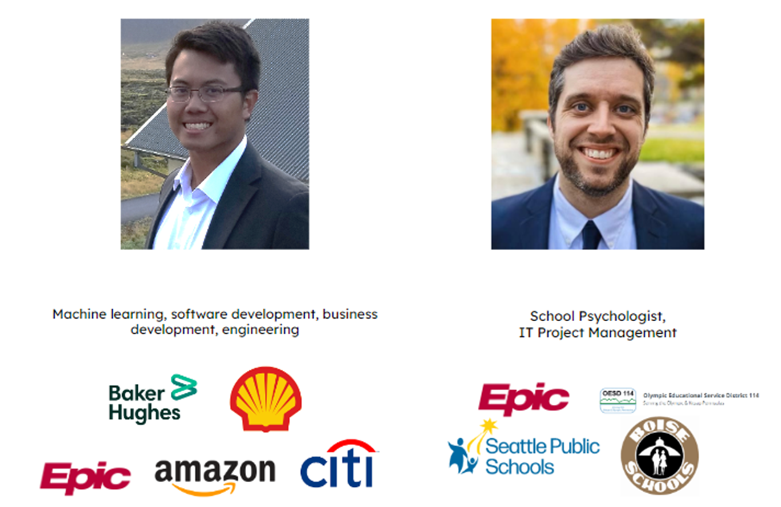
Intro
Dani Sofjan
Technical Product Manager
Austin Abromeit
Product Manager

Slide 8
Experience with AI
Undergraduate | University of Texas (Austin) – Petroleum Engineering, B.S.
Undergraduate Research Assistant – surfactant and polymer research, fluid dynamics
Oil and Gas (3 years)
Baker Hughes – reservoir engineering and statistical modeling, field development
Shell – deepwater drilling R&D
Healthcare (3 years)
Epic – Predictive analytics for post-operative pediatric surgeries
Tech (3 years)
Amazon – audio speech recognition, computer vision, image identification and creation, sentiment annotation, financial modeling, edge computing
Edtech (1.5 years)
Ai-ai – report writing for school psychs (Lightner)
Finance (Current)
Citibank – AI & automation projects for consumer banking applications

Slide 9
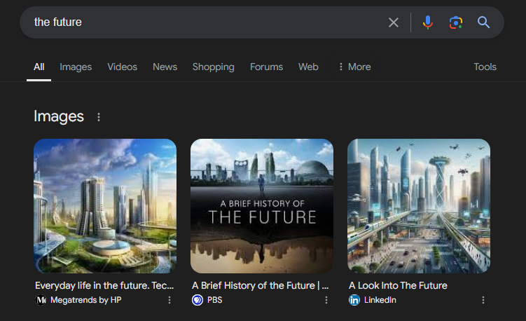
Statement of Intent
Provide you the fundamentals such that you can come up with your own vision of the future

Slide 10
Agenda
TRUST
TIME
ATTENTION
CONSIDERATION

Slide 11
Predicting the Future for School Psychologists
AI & ML models will continue to improve & evolve
Foundational support for specialty domains will be more readily available
Productivity-related KPIs improve at regional and State levels
Districts with high adoption will report higher job satisfaction and velocity per FTE → more positive outcomes for students and higher throughput
Districts with lower adoption will fall behind dramatically compared to counterparts → staff burnout will lead to talent retention issues
Administrators will have to decide what to do with improved staff utilization metrics → some will protect newly realized FTE time to improve intervention program delivery; some will reduce workforces; some will increase caseload to backfill “non-productive time”
Case load will shift to agencies

Slide 12
Predicting the Future for School Psychologists

Slide 13
School Psych Economics
State Funding
Federal Funding
Local Funding
Special Programs and Grants
Mental Health Services Act (MHSA)
School-Based Mental Health Services Grant Program (SBMH)
Student Mental Health Initiative (SMHI)
Special Education Mental Health Services (AB 114)
School Climate Transformation Grants
Children and Youth Behavioral Health Initiative (CYBHI)
Project AWARE (Advancing Wellness and Resilience in Education)
Local Control and Accountability Plan (LCAP) Funding
Hire school psychs -> help students -> ??? -> success

Slide 14
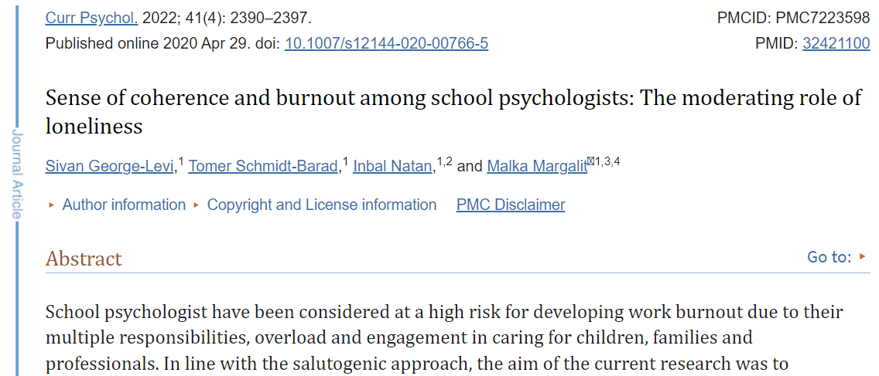
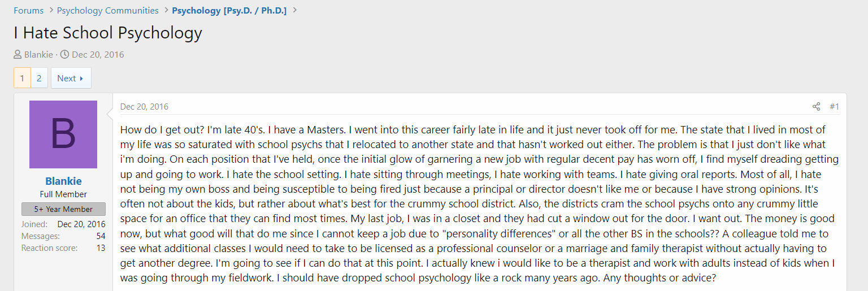
School Psych Economics

Slide 15
Late-stage Capitalism Impact on EdTech
In general, education workers are:
Underpaid
Understaffed
Underequipped
Underfunded
Underappreciated
Overworked
Unsatisfactory job conditions
Lack mobility

Slide 16
Late-stage Capitalism Impact on EdTech
Budgets are controlled by legislators and administrators
Lobbyists affect administration decisions; budget reductions across the board
Misalignment in priorities and unrealistic expectations onset
Public schools make do with what they can based on allocations
Operations and policies are defined by available resources
Front-line staff’s (teachers, school psychs, etc.) livelihoods shape around policies
Adverse effects to staff work-life balance impacts ability to help students

Slide 17
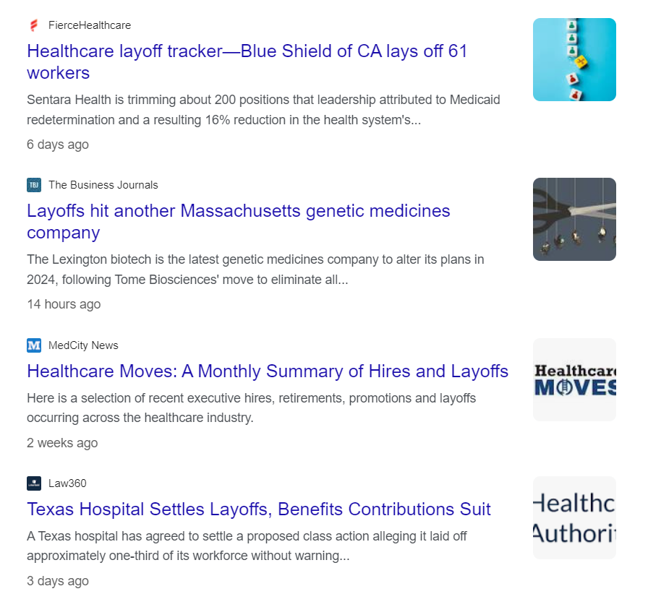
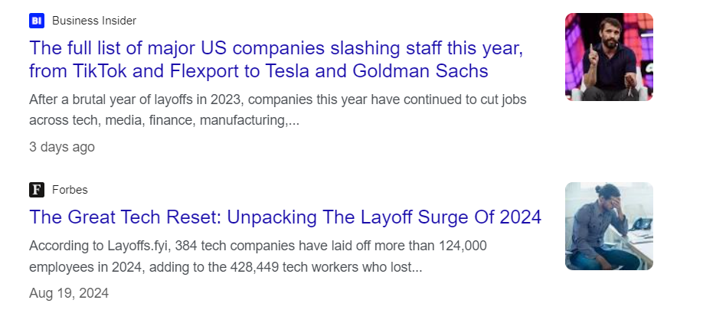
Trends in Relatable Industries

Slide 18
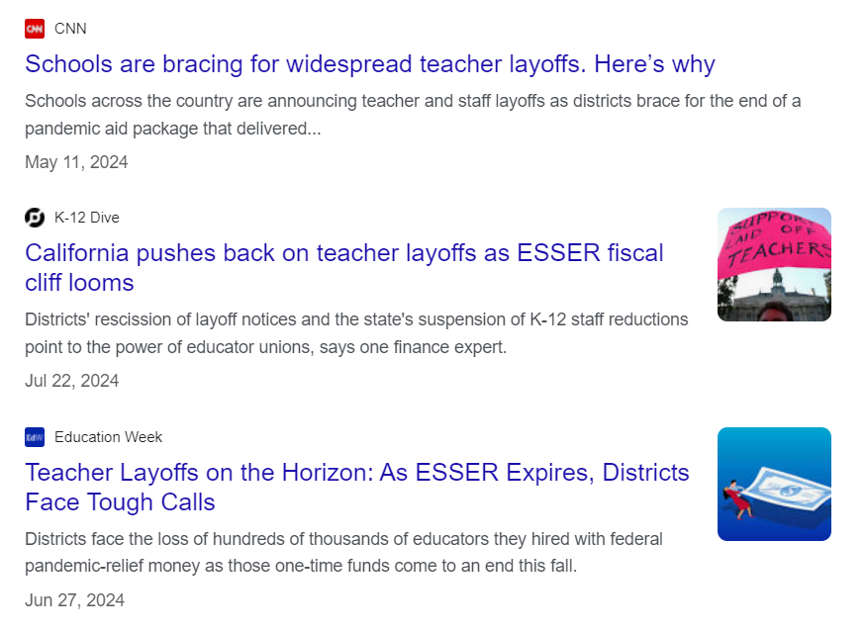
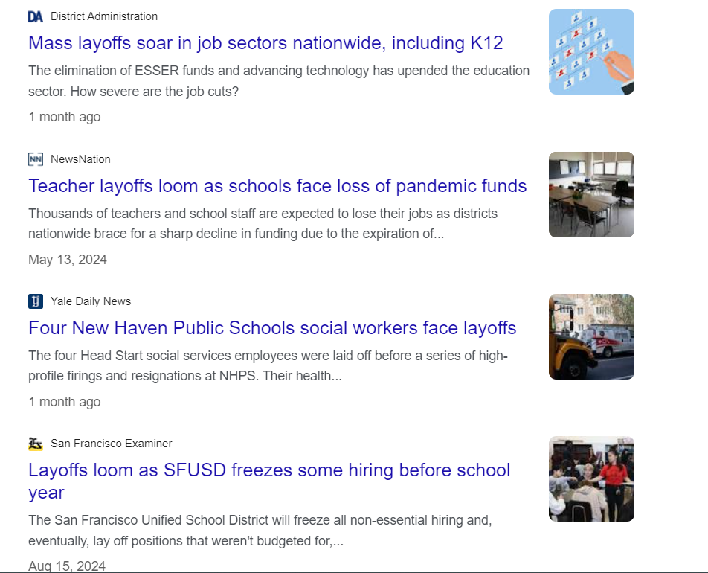
Trends in Relatable Industries

Slide 19
Knowledge Check 1
What does GPT stand for?

Slide 20
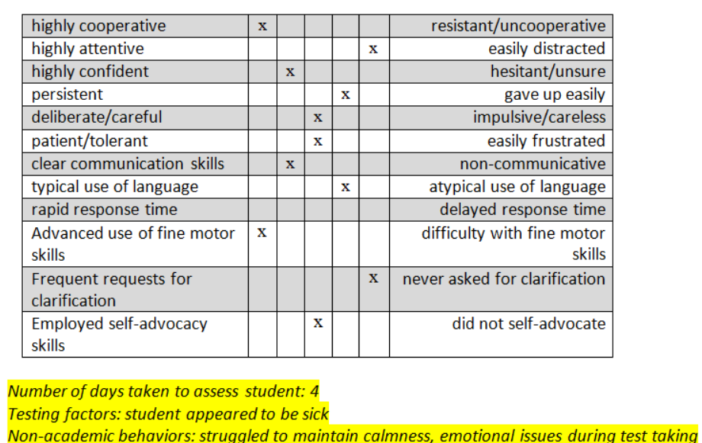
Automating Test Observation – Exercise with MUSD

Slide 21
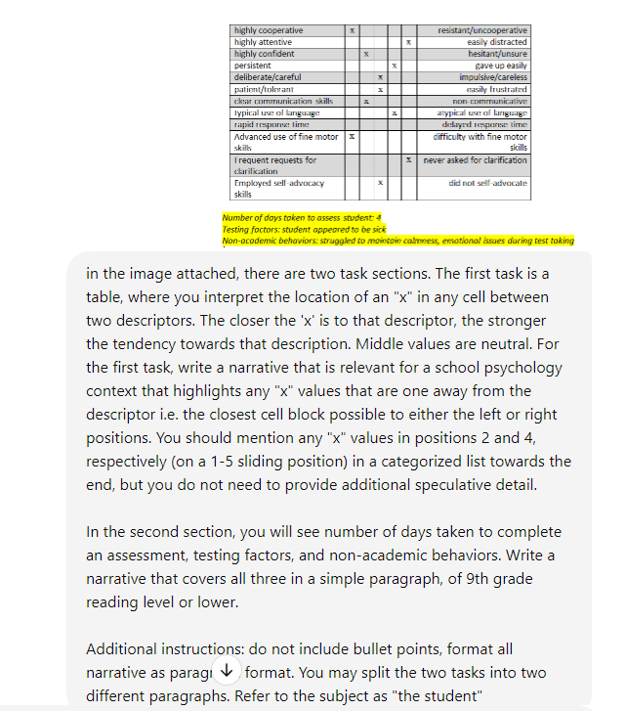
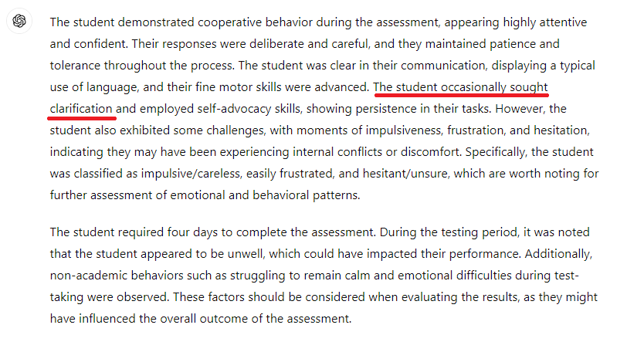
AI failing a simple task

Slide 22
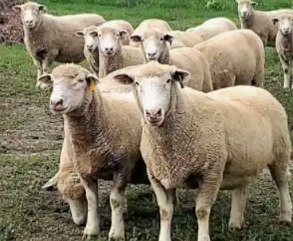
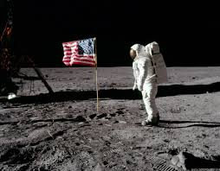
Preparing for the Future

Slide 23
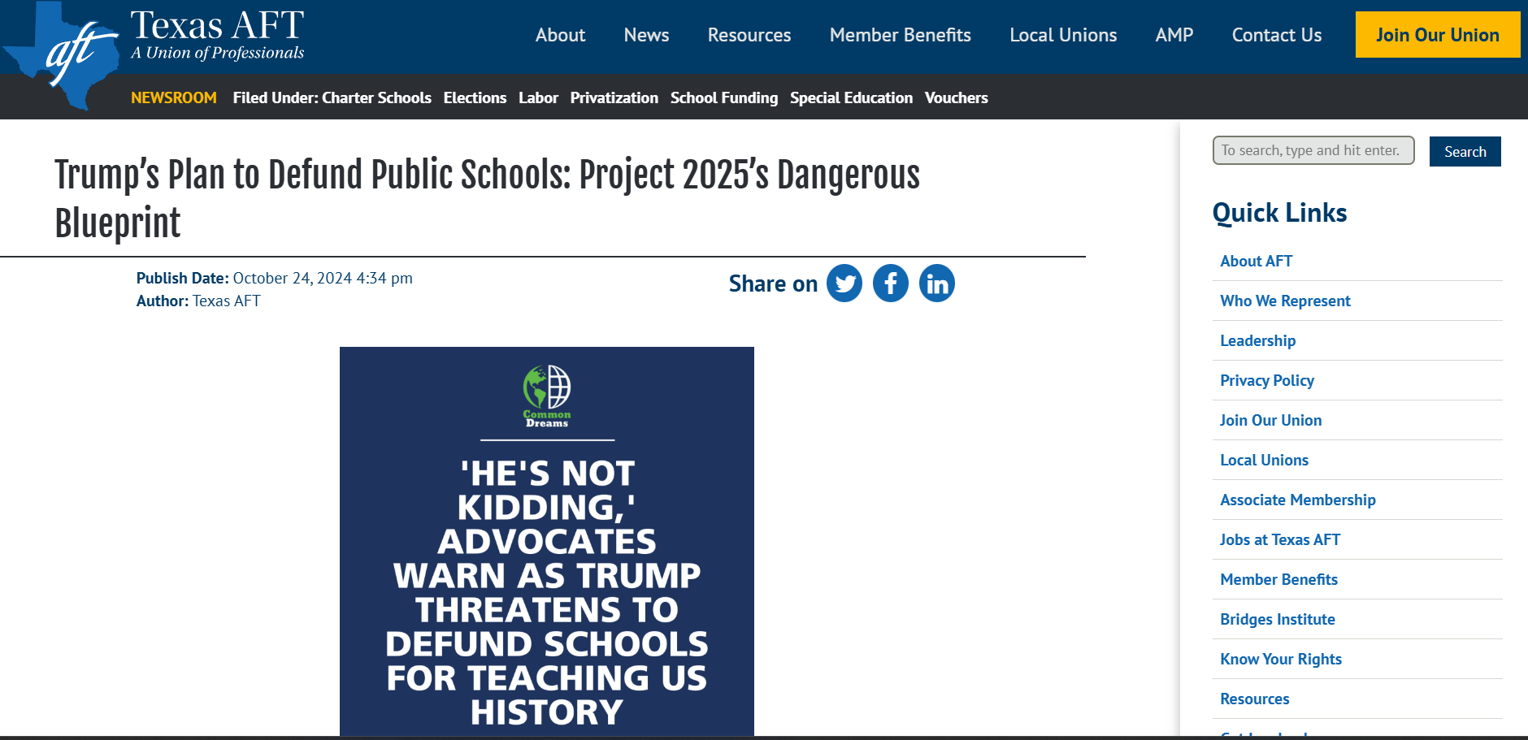
Ouch (link to site)

Slide 24
Agenda
TRUST
TIME
ATTENTION
CONSIDERATION

Slide 25
Knowledge Check 2
Link

Slide 26
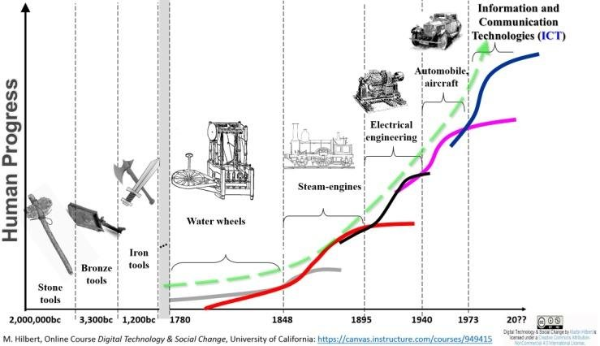
Timeline of technology

Slide 27
Timeline of technology

Slide 28
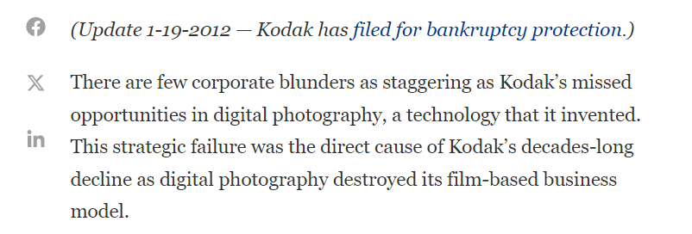
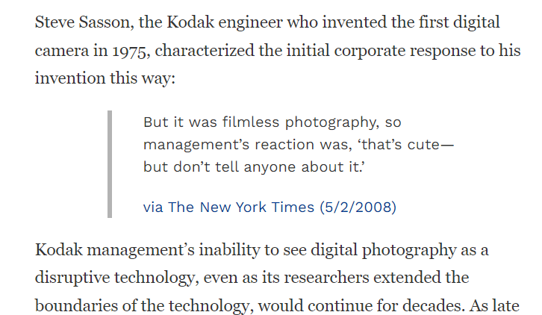
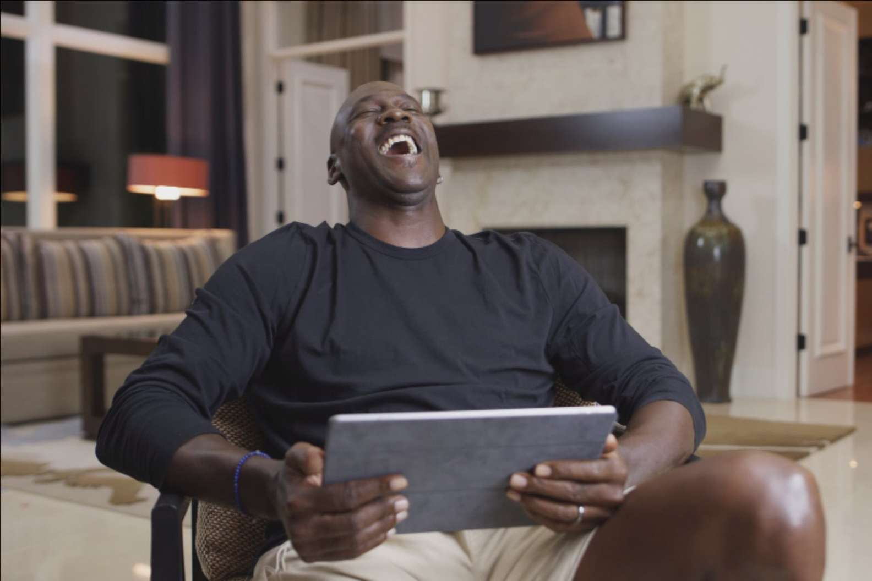
Timeline of technology

Slide 29
Timeline of technology

Slide 30
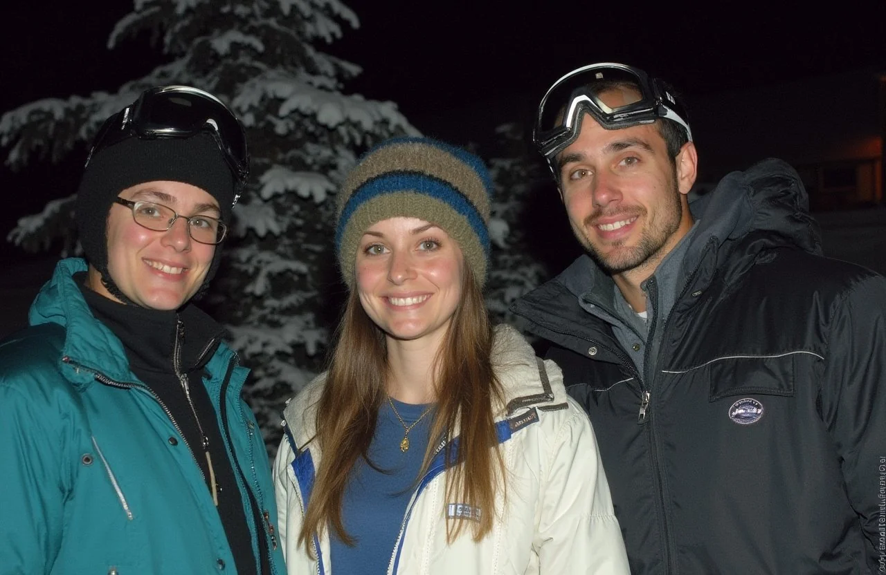
Timeline of technology

Slide 31
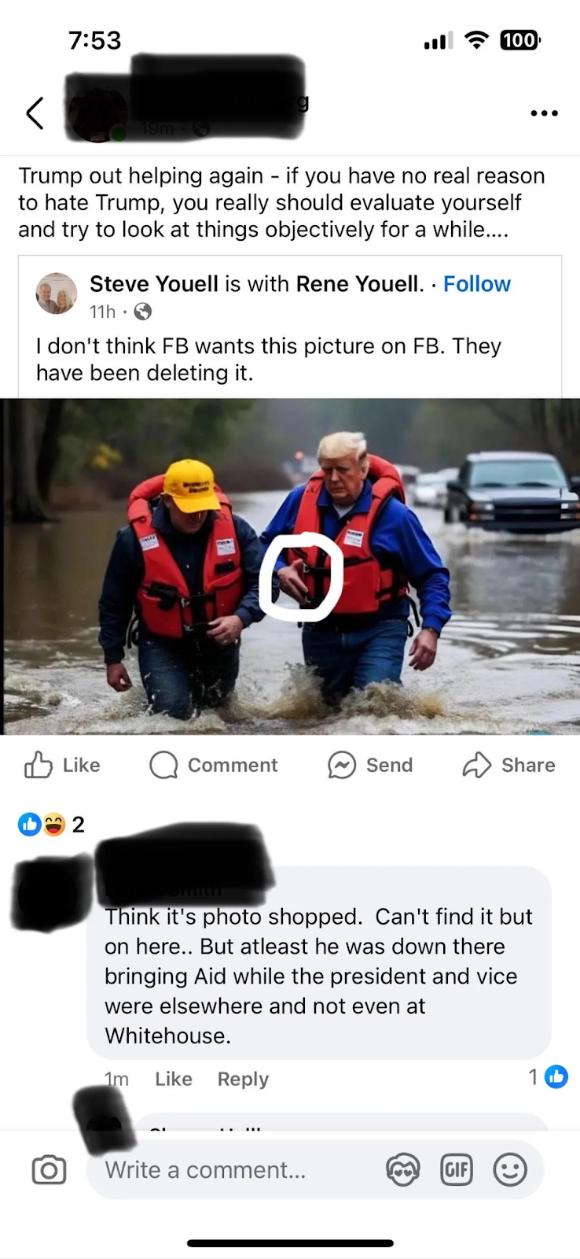
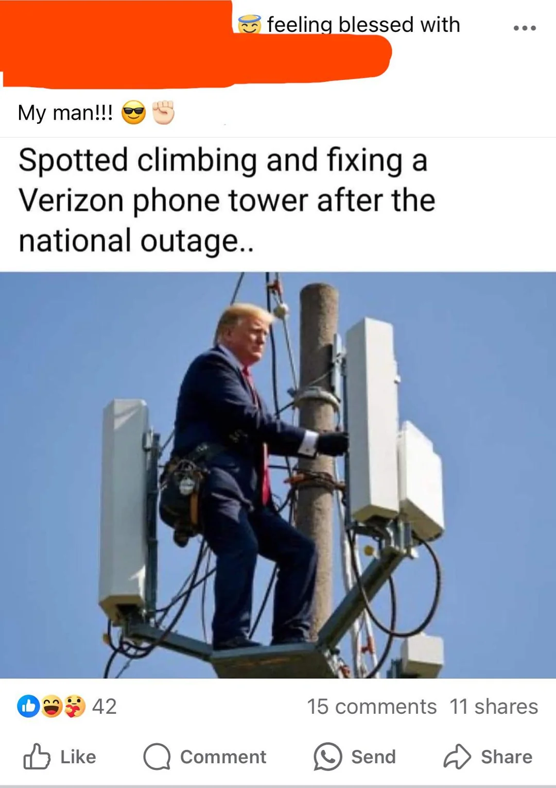
Timeline of technology

Slide 32
History of AI
1943 - The first math model of a neural network to create algorithms that mimic human thought processes is published
1949 - “The Organization of Behavior: A Neuropsychological Theory” on how behavior and thought in terms of brain activity relate to machine learning and neural networks was published
1950 - Turing test established; helped popularized the concept of “AI” to the masses
1952 - The world's first self-learning program to play games
1956 - The term “artificial intelligence” is proposed for the field and its researchers
1959 - "Pandemonium: A Paradigm for Learning" was published, which described a model capable of adaptively improving itself to find patterns in events
1963 - A program learned how to play a perfect game of tic-tac-toe
1965 - An AI system that assisted organic chemists in identifying unknown organic molecules was developed; landmark industrial successful use-case
1966 - Eliza, capable of engaging in conversations with humans and making them believe the software has human-like emotions, was released

Slide 33
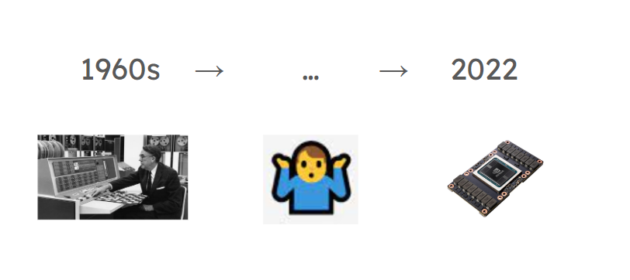
History of AI

Slide 34
History of AI

Slide 35
History of AI

Slide 36
History of AI [present day]
Examples of AI products in other industries:
Autonomous Units (e.g. Self-Driving)
AI-Powered Chatbots
Sentiment Analysis Tools
Facial Recognition Systems
Fraud Detection Systems
Predictive Analytics Platforms
Robotic Process Automation (RPA)
AI-Powered Translation Tools
Emotion Recognition Tools
AI-Based Medical Imaging Tools
Speech Recognition Software
AI-Driven Cybersecurity Platforms
AI-Based Market Research Tools
Virtual Influencers
AI-Powered Personalization Engines
Self-Learning AI Tutors
AI-Powered Talent Sourcing Platforms
AI-Based Drug Discovery Platforms
Industry-defining potential for edtech:
Large Language Models
Voice Assistants
Image Generation
Recommendation Engines
Video Generation

Slide 37
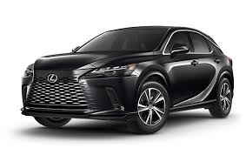
ML Fundamentals

Slide 38
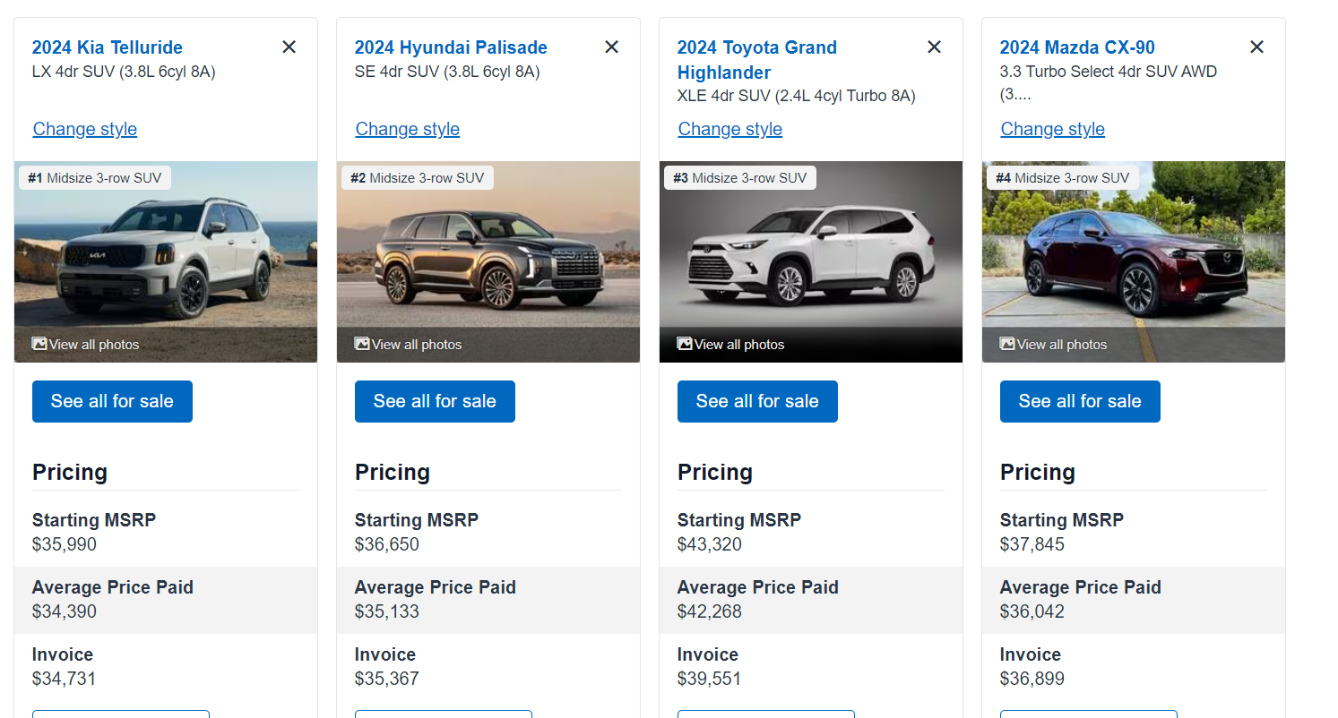
ML Fundamentals

Slide 39
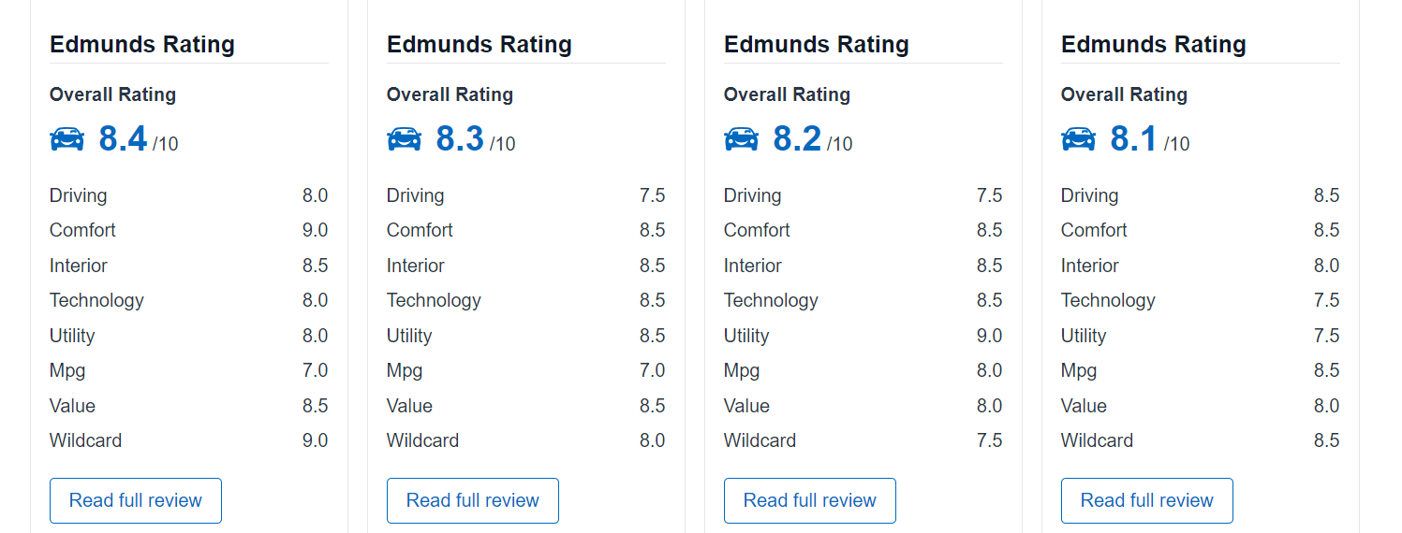
ML Fundamentals

Slide 40
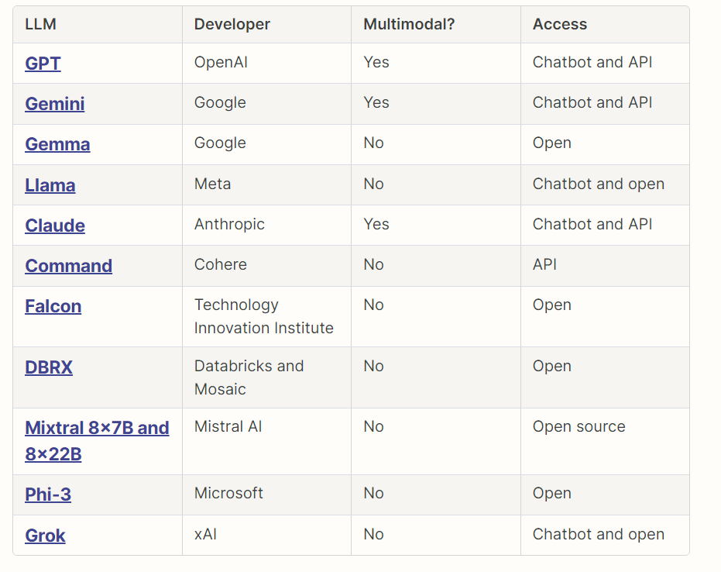
ML Fundamentals

Slide 41
ML Fundamentals

Slide 42
ML Fundamentals
Wrapper: a software application or tool that leverages the underlying capabilities of a model while adding additional layers of functionality, interfaces, or customizations for specific use cases.
LLM
User
Wrapper

Slide 43
ML Fundamentals
Model Training
Neural Networks
Supervised Learning
Unsupervised Learning
Reinforcement Learning
Feature Engineering
Data Preprocessing
Overfitting and Underfitting
Evaluation Metrics
Cross-Validation
Hyperparameter Tuning
Ensemble Methods
Natural Language Processing (NLP)
Computer Vision
Transfer Learning
Deep Learning
Generative Models
Ethics and Bias in Machine Learning

Slide 44
Importance of Training Data & Training Methodologies
“We don’t rise to the level of our expectations, we fall to the level of our training.”
Production data
Synthetic data
Augmented data
Simulated data
Historical data
Crowdsourced data
Expert-generated data
Supervised Learning
Unsupervised Learning
Semi-Supervised Learning
Reinforcement Learning
Transfer Learning
Deep Learning

Slide 45
Knowledge Check 3
What was GPT 4.0 trained on?

Slide 46
Knowledge Check 3
“Subscription-Based or Private Data: The training data does not include any proprietary, subscription-based, or closed-access content (e.g., private emails, messages, databases, or paid media platforms) unless it was explicitly made publicly available. For instance, data from behind paywalls or copyrighted media not available on public platforms was not used.”

Slide 47
Cost of training a model

Slide 48
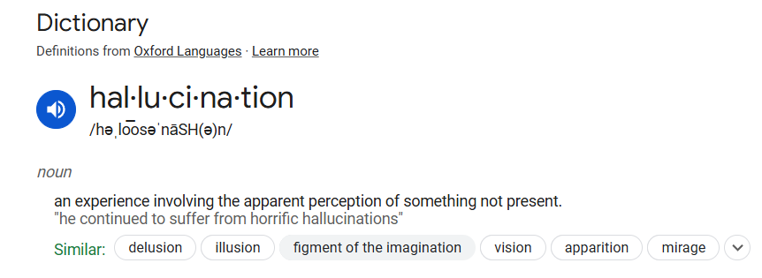
AI’s Biggest Blocker

Slide 49
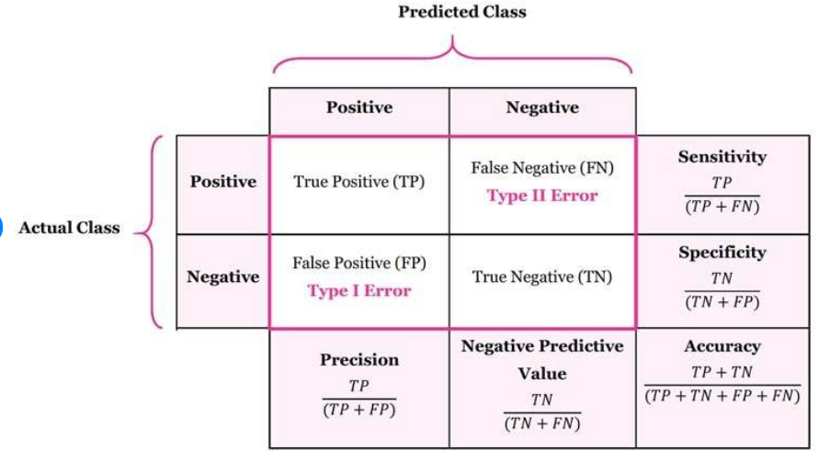
Quality Metrics

Slide 50
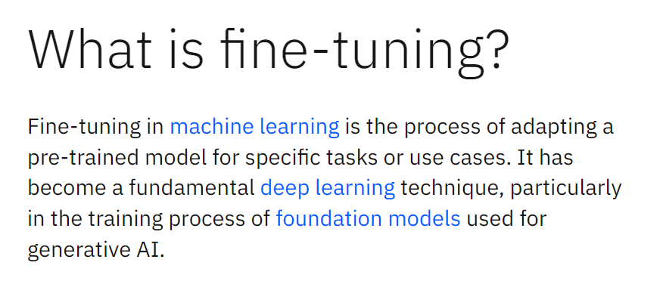
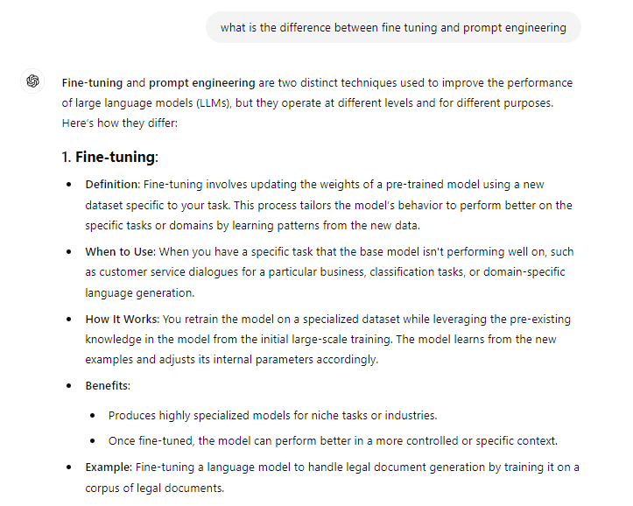
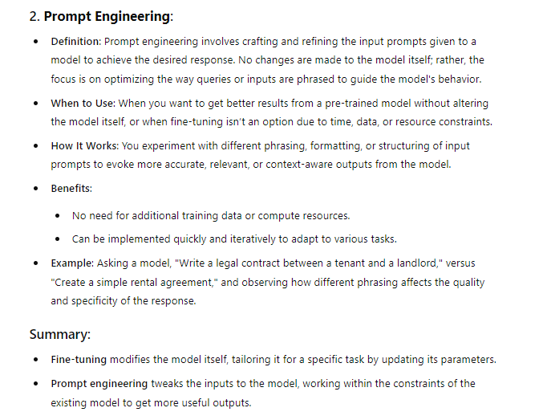
Fine Tuning vs Prompt Engineering

Slide 51
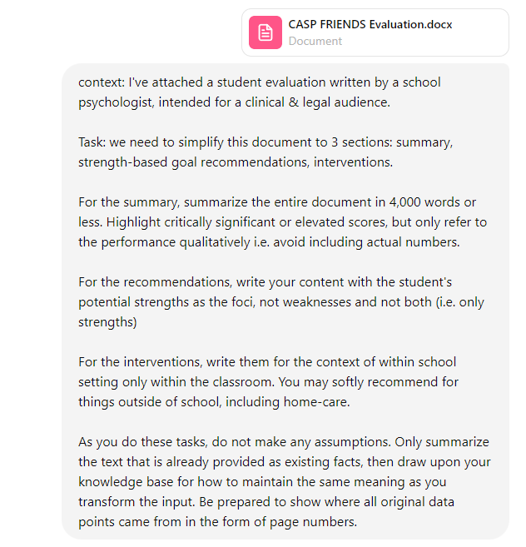
Reducing Hallucination
context: I've attached a student evaluation written by a school psychologist, intended for a clinical & legal audience.
Task: we need to simplify this document to 3 sections: summary, strength-based goal recommendations, interventions.
For the summary, summarize the entire document in 4,000 words or less. Highlight critically significant or elevated scores, but only refer to the performance qualitatively i.e. avoid including actual numbers.
For the recommendations, write your content with the student's potential strengths as the foci, not weaknesses and not both (i.e. only strengths)
For the interventions, write them for the context of within school setting only within the classroom. You may softly recommend for things outside of school, including home-care.
As you do these tasks, do not make any assumptions. Only summarize the text that is already provided as existing facts, then draw upon your knowledge base to maintain the same meaning as you transform the inputs. Be prepared to show where all original data points came from in the form of page numbers. Apply a temperature setting of 0.1

Slide 52
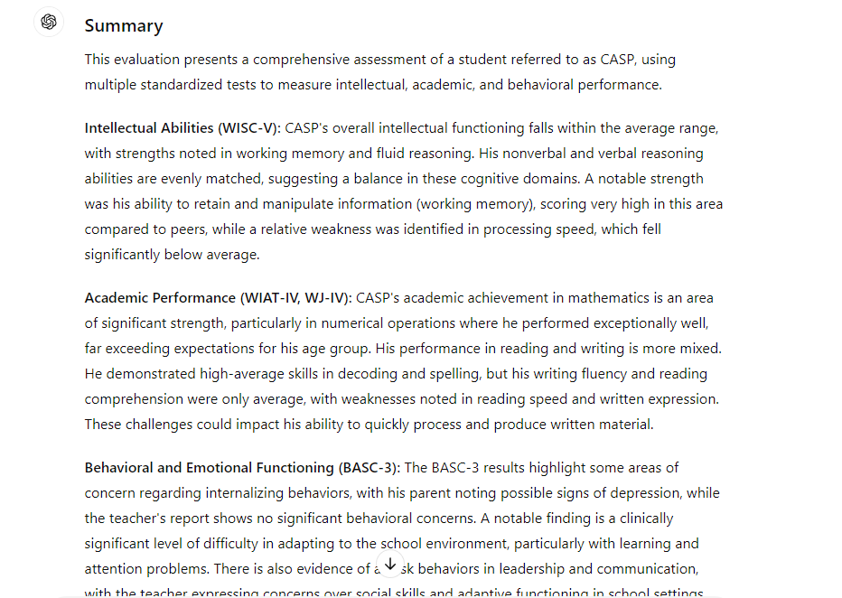
Reducing Hallucination

Slide 53
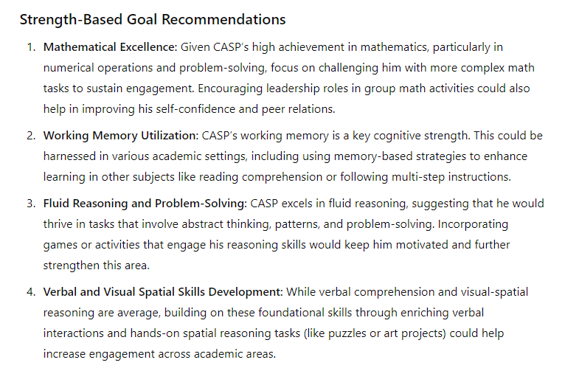
Reducing Hallucination

Slide 54
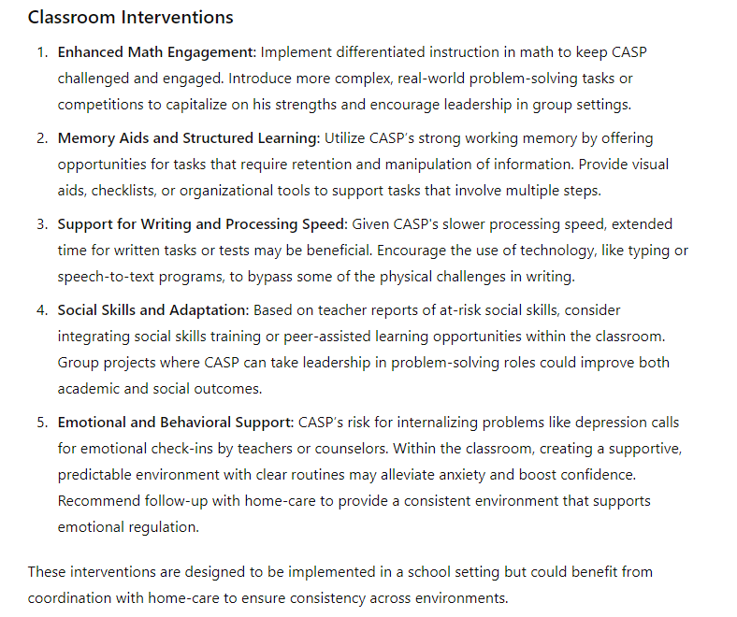
Reducing Hallucination

Slide 55
Agenda
TRUST
TIME
ATTENTION
CONSIDERATION

Slide 56
Power of Knowledge

Slide 57
Predicting the Champion

Slide 58
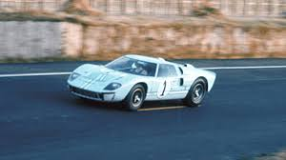
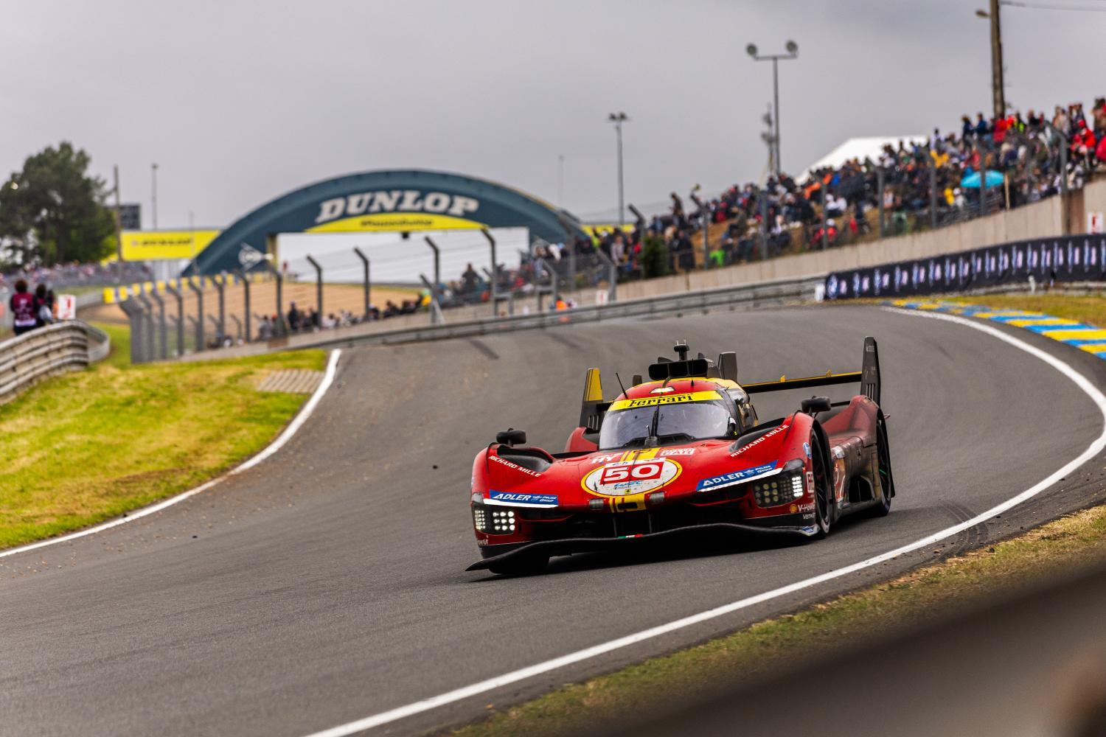
Predicting the Champion

Slide 59
Your Impact on the World

Slide 60
Lightner + Key Performance Indicators
Lightner – customizable & modernized report writer
Precision: >= 95%
Recall: >= 95%
Number of users = ~1,000
Number of US states represented = ~35
95th percentile of time saved per eval = 4 hours
Avg/expected time saved per eval = 1-2.5 hours

Slide 62
Productivity Indexes
[A] hours saved X [B] FTE rate in $/hour X [C] number of evals = value
Additional time to interact with students
Reduced burnout/higher retention
Standardization [=] higher output consistency
Sample calculation:
20 school psychs X 2 hours saved X 100 evals per year X $100/hr =
$400,000 in annual productivity savings

Slide 63
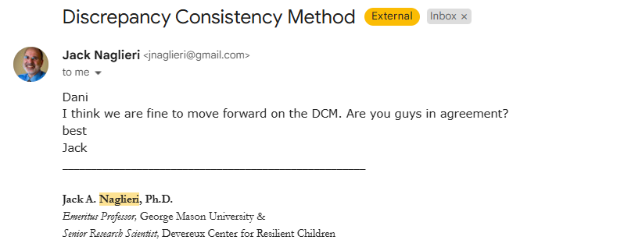
Product Roadmap
Patterns of strengths and weaknesses (PSW-based) output
Interoperability with other roles (Occ. Therapists, Speech Language Pathologists, Diagnosticians, SPED Teachers, Administrators, etc.)
Collaborations with principal subject matter experts
~40 of the most commonly used reports nationwide

Slide 64
Demo
Link to Lightner website

