Slide 1
Supporting Autistic & Neurodivergent Students with College Transition
Ashley Richardson, LCSW-S
Program Director, Longhorn TIES Autism and Neurodiversity Support, The University of Texas at Austin

Slide 2
Cultural Humility Statement
We are here to discuss autism and neurodiversity. As such, we need to acknowledge our differing experience as neurotypical clinicians. Even though we work with neurodivergent clients and try to represent their strengths, needs, and perspectives, we recognize that we are not the experts and do not have the lived experience to truly understand what it is like to be autistic or neurodivergent.​

Slide 3
Learning Objectives
Describe the challenges autistic and neurodivergent students face entering post-secondary support programs.
Identify at least one resource and/or strategy that can assist autistic students and their families transition into the collegiate setting.
Participants of this training will be able to….

Slide 4
Transition Services

Slide 5
What does the data say?
“Postsecondary completion rates for students with ASD remain significantly lower (39%) than that of their peers in the general population (59%) or of that for students with all types of disabilities (50%).”
They also have “higher rates of loneliness, anxiety, depression, and an increased rate of dropping out before degree completion.”
Petcu SD, Zhang D, Li YF. Students with Autism Spectrum Disorders and Their First-Year College Experiences. Int J Environ Res Public Health. 2021 Nov 11;18(22):11822. doi: 10.3390/ijerph182211822. PMID: 34831577; PMCID: PMC8622457.

Slide 6
Transition Services
According to TEA, starting at age 14 “transition services are a coordinated set of activities designed to help the child move from school to post-school activities”.
How do parent’s define Transition Services?
How do student’s define Transition Services?
https://tea.texas.gov/academics/special-student-populations/special-education/transition-and-employment-guide.pdfn as

Slide 7
The Unknown and Known
Parent Fears
How will I know how they are doing (academically, physically, mentally, etc.)
Who will help advocate for my young adult? I have always done it.
My young adult is anxious-how will they cope?
What is my role now?
Student Fears
I am not sure how to make friends.
Will I make friends?
My peers don’t understand me.
Do I deserve to be here?

Slide 8
AUTISM AND ADHD IN COLLEGE

Slide 9
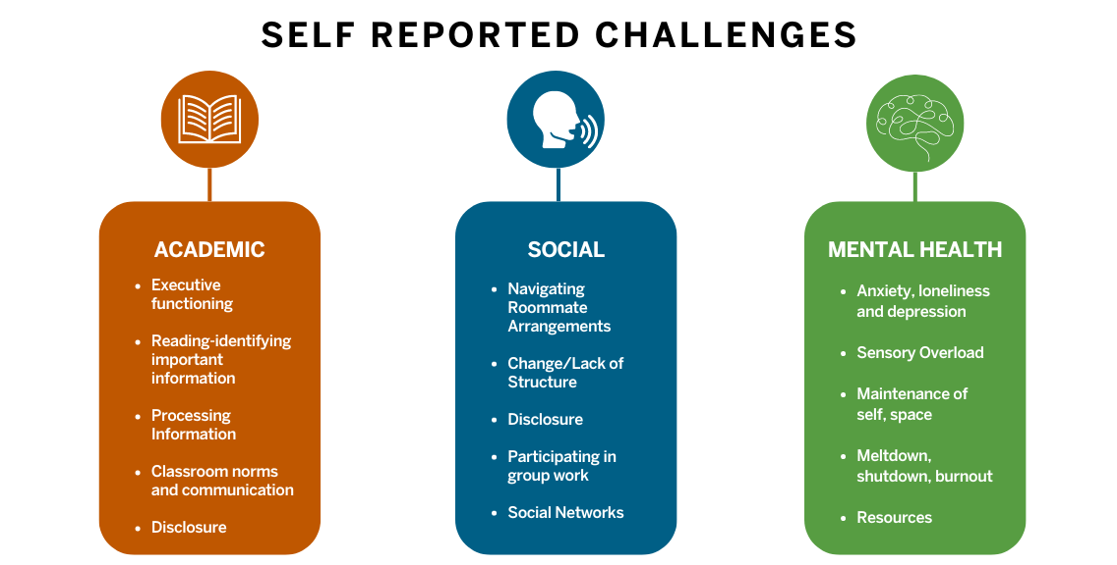

Slide 10
TIPS AND STRATEGIES

Slide 11
Supporting the Student with Transition
Help facilitate questions
What supports do I receive now that may be needed when I’m an adult? Based on environment. Dorm? Staying at home?
What can I do now to make sure I have supports after I graduate?
What skills can I learn that I will need in adulthood?
College life: assist in understanding accommodations
Foster the power to make decisions
Unstructured time…what is that?
Identification of strengths
Normalize self discovery
becoming an adult and learning who you are
Realistic goal setting-career and beyond

Slide 12
Supporting the Parents with Transition
Understand the college process and share the process with the student
“My mom is like my secretary”
Inform and Share
Assist in teaching life skills
Emails: checking and responding
Distress tolerance for task completion
Start the independent learning for non-academic tasks
Create opportunities for decision making
Create opportunities for students to fail and learn
Be realistic about student’s strengths and challenges
Parent coaching

Slide 13
RESOURCES AND LONGHORN TIES

Slide 14
https://youtu.be/p2_qXn8LWI0?si=kNXrAcUAg2kvz5Er

Slide 15
Longhorn TIES Autism and Neurodiversity Support

Slide 16
Resources
Resources
College Autism Network
Links varied stakeholders engaged in evidence-guided efforts to improve access, experiences, and outcomes for postsecondary students with autism.
https://collegeautismnetwork.org/
College Autism Spectrum
https://collegeautismspectrum.com/services/
Organization for Autism Research
https://researchautism.org/
Trainings
Autism Career Empowerment-Vanderbilt Kennedy Center Learning
https://vkclearning.org/
Landmark College
https://lconline.landmark.edu/programs-for-educators/
Self advocates on media platform of choice

Slide 17
Contact
Longhorn TIES Website:
https://newstudentservices.utexas.edu/longhorn-ties
Ashley Richardson-Minnitt, LCSW-S Director, Longhorn TIES
Ashley.Richardson@austin.utexas.edu

