Slide 1
FBA’s & BIP’s: The Magic Pill
Korbin Williams

Slide 2
Who are you?
Notes:
School Psychologists
Directors
Advocates
Parents

Slide 3
Who are we?
Husband
Father
Pilot
School Psychologist
BCBA
Caption
Notes:
I love challenges

Slide 4
Who are we?
Wife
Mother
Adventurer
Former Teacher & Administrator
Attorney
Notes:
Jennifer Carroll

Slide 5
Challenging Thoughts
I’m not a doctor.
Notes:
Although I believe in supporting the mental health of our students and supporting behavior change the focus of this presentation is data driven BIP’s that are developed from a solid data reinforced FBA.

Slide 6
our goalS for today
Challenge your approach to FBA’s and BIP’s
Explain my approach in depth. Beginning to End.
For you to learn one new thing. Not a million. One.
Learn from you. I plan to take one NEW skill or view home with me after our group break out sessions.

Slide 7
Schedule
Starting an FBA. My approach.
Groups (Plan your FBA based on the scenarios provided)
Plan it
How will you complete the FBA?
1st
2nd
3rd
Break
Why the FBA “is” the BIP
Where is the guidance?
What’s required?
My approach
BIPs and Group

Slide 8
SAVE THIS ON YOUR computer
https://tea.texas.gov/academics/special-student-populations/special-education/behavior-guide-2022.pdf
Pg. 19
Notes:
We will be using this link all day today. I would save it as a PDF on my phone or my computer.
This is your go to resource and should be used often. Make sure that you follow all of the requirements. They tell you what you want.

Slide 9
Department of Education Guidance
The Department of Education provided that an FBA focuses on identifying the function or purpose behind a child’s behavior. Typically, the process involves looking closely at a wide range of child specific facts (e.g., social, affective, environmental). Knowing why a child misbehaves is directly helpful to the IEP Team in developing a BIP that will reduce or eliminate the misbehavior.
See Questions and Answers on Discipline Procedures, Q & A E2 (Revised June 2009).

Slide 10
Functional Behavior Assessment
Texas Education Code § 37.004 requires that the school must seek consent to do an FBA when the school seeks to take disciplinary action that amounts to a change in placement.
A new FBA is not required if the school has done one within the past year, but otherwise, a disciplinary change of placement requires an FBA.
Beyond this, the law is silent on when and how to conduct an FBA.

Slide 11
More Specifically
If the LEA takes a disciplinary action regarding a child with a disability who receives special education services that constitutes a change in placement, the LEA will, no later than the 10th school day after the change in placement:
Seek consent from the child's parent or person standing in parental relation to the child to conduct an FBA of the child, if an FBA has never been conducted on the child or the child's most recent FBA is more than one year old; and
Review any previously conducted FBA of the child and any BIP developed for the child based on that assessment; and as necessary:
Develop a BIP for the child if the child does not have a plan OR
If the child has a BIP, then revise it.
See TEC 37.004(b-1)

Slide 12
WHAT DOES THIS MEAN?
This means that at every MDR,
Regardless of whether the behavior is a manifestation,
The district must provide the parent with a Notice of Evaluation and Consent for Evaluation,
UNLESS the student has an existing FBA that is less than one year old.
The law does not specifically require it, but I highly recommend:
Seeking consent for a FBA even if it is less than a year old,
If the conduct subject to discipline is not one of the target behaviors of the existing FBA

Slide 13
Who can Conduct FBAs and is Consent required?
The law does not contain any requirements regarding the qualifications of the individual conducting an FBA, or draft a BIP.
But a district must ensure that those who do conduct them are adequately trained.
Yes, you need parental consent to conduct the FBA.

Slide 14
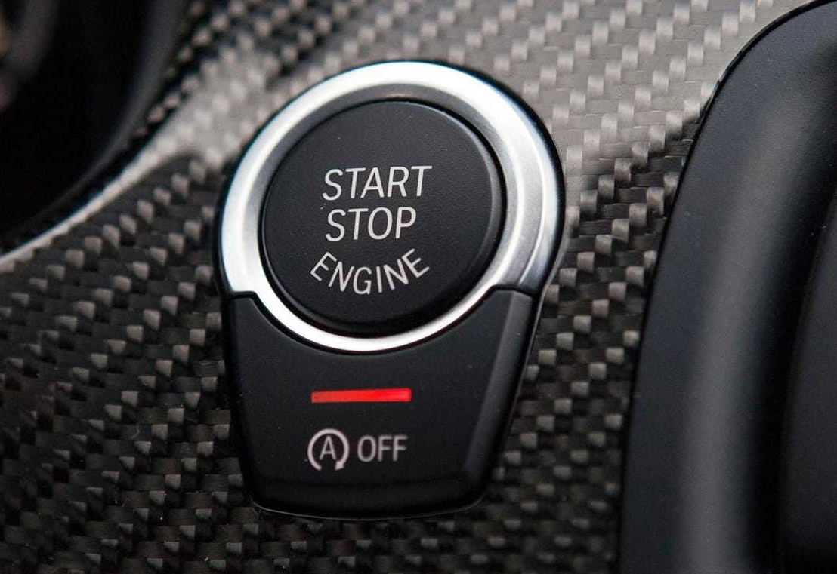
FBA: Step 1
Notes:
You tell me. When should you complete an FBA?
Where do you start?
Should it just be one person?
When is an FBA required?
Federal law under the Individuals with Disabilities Education Act (IDEA) requires an FBA in the following instances:
• When, at a MANIFESTATION DETERMINATION review (MDR), it is determined that a student’s behavior is a manifestation of the student’s disability (unless the LEA had conducted an FBA before the behavior that resulted in the change of placement occurred)
• When, at an MDR, it is determined that a student’s conduct is not a manifestation of the disability, but the ARD committee determines that an FBA is necessary
• When a student is placed in an interim alternative educational setting (IAES) for not more than 45 school days for behavior involving a dangerous weapon, illegal drugs, or infliction of serious bodily injury (unless the LEA had conducted an FBA before the behavior that resulted in the change of placement occurred)
However, STATE LAW also requires that whenever a disciplinary action results in a CHANGE OF PLACEMENT the LEA must no later than the 10th school day after the change of placement:
• Seek parental consent to conduct an FBA of the student if an FBA has never been conducted on the student or the student's most recent FBA is more than one year old; and
• Review any previously conducted FBA of the student and any BIP developed for the student based on that assessment; and as necessary
• Develop a BIP for the student if the student does not have a plan; or
• If the student has a BIP, revise the student’s plan

Slide 15
Teacher
Notes:
Teacher reports behavior and we call for the FBA?
Principal tells you to do it?
Parent calls for it?
When can you do it or may should consider it?
When an FBA should be considered:
When a student’s behavior impedes their learning or the learning of others
When a student’s behavior presents a danger to themselves or others
When a student’s suspension or placement in an IAES approaches 10 cumulative days
When interfering behavior is preventing progress on IEP goals
When new behavioral challenges are keeping a student from making progress
When a restraint occurs, especially if staff must restrain a student on more than one occasion.

Slide 16
FBA: Step 1
What is the behavior?
Persistent misconduct :)
That’s a joke
What is the exact behavior in question?
Is it an actual behavior?
Meet with teachers
Meet with student
GET A DEFINITION
Notes:
I don’t want to start with a vague definition. I want the exact behavior. We do not tiptoe around feeling when it comes to behavior. We are either honest or we do not need to be working with behavior.
NEED TO GET ME A DEFINITION OF A SPECIFIC BEHAVIOR

Slide 17
FBA STEP 1: GROUP TIME
Notes:
I want you to get in groups. Find a behavior on YouTube and start your definitions for the behavior you observed. Write down your steps. I want you to teach me how you should approach this.

Slide 18
FBA STEP 2:
Observations (with no behavior)
I spend 15 minutes to start. (I know that’s crazy)
No Bx, I leave.
Swing through at a different time
Another 15 minutes
If I don’t see behavior in 3 days of random time samples I will come back and spend longer but never an entire day.
What does the data say about high rate behavior?
Revisit the definition

Slide 19
FBA Step 2 :
Bx is observed
Track it
Watch it
Stay out of it (mental hypothesis of behavior)
Do not start telling the person what they are doing wrong
We can learn a lot by observing
Monitor all interactions
This means teachers, admin, other students
Track it (yes, I repeat this often)
This is where ABC data will be logged
Make an ABC form for your phone or iPad
Keep it simple
DO NOT WRITE A PARAGRAPH.

Slide 20
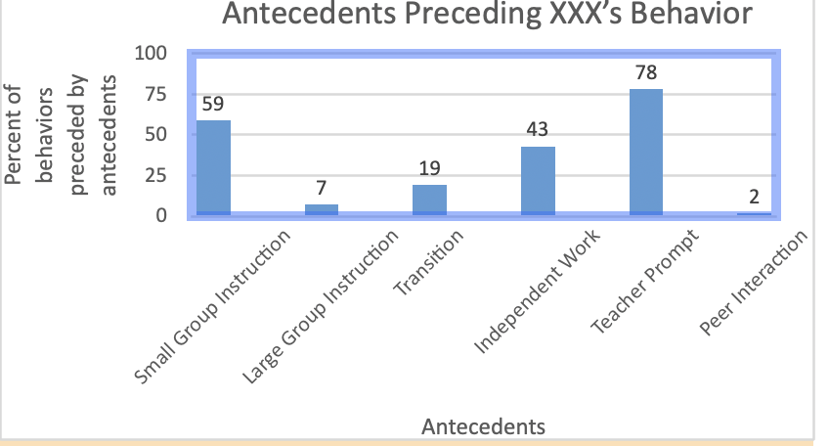

Slide 21
Access Denied | Flopping | Physically guided to comply
Task request | Verbal Refusal: “Screw You!” | Ignored
Task Request | Punching wall with closed fist | Verbal redirect paired with space. “Let me know when you are ready.”
Notes:
We have to have data. Its not an option to not have data! We have to have it. If I am told that someone observed behavior but does not have data I do not count that behavior in my FBA. Period.

Slide 22
Hypothesis (have to test it!!)
Notes:
We need to test our hypothesis during the fba.
We need to attempt the interventions ourselves and then teach staff how to implement the intervention.
This is where the FBA takes up your time.
If its a serious behavior I do this in one day and write the FBA and BIP that day! I do not wait to write it. Even with 50 FBAs I will prioritize my FBA for serious behaviors.
We will need to graph our interventions. I do not support subjective opinions.
We want to slap the data down and let it speak for us.
If staff starts to state subjective opinions that are not trackable we put them to the side unless our hypothesis and intervention do not show a change in behavior.
I would like for volunteers to come up and write an example of a hypothesis of a behavior they have encountered.

Slide 23
TOP 3 Interventions
Notes:
NCR: by far my favorite intervention
CR (good behavior game)
DRA
DRO

Slide 24
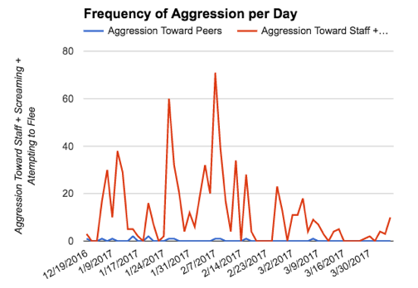

Slide 25
Notes:
We want to collect clear data. YOUTUBE how to make a graph. We need data in the FBA to see if we seeing changes or not after our intervention. We have to then test out hypothesis. Again, subjective opinions will not benefit you or the child. We must be able to track if there is a change in behavior or if the behavior stayed the same. Here we have a phase line that shows when we implemented the intervention.

Slide 26
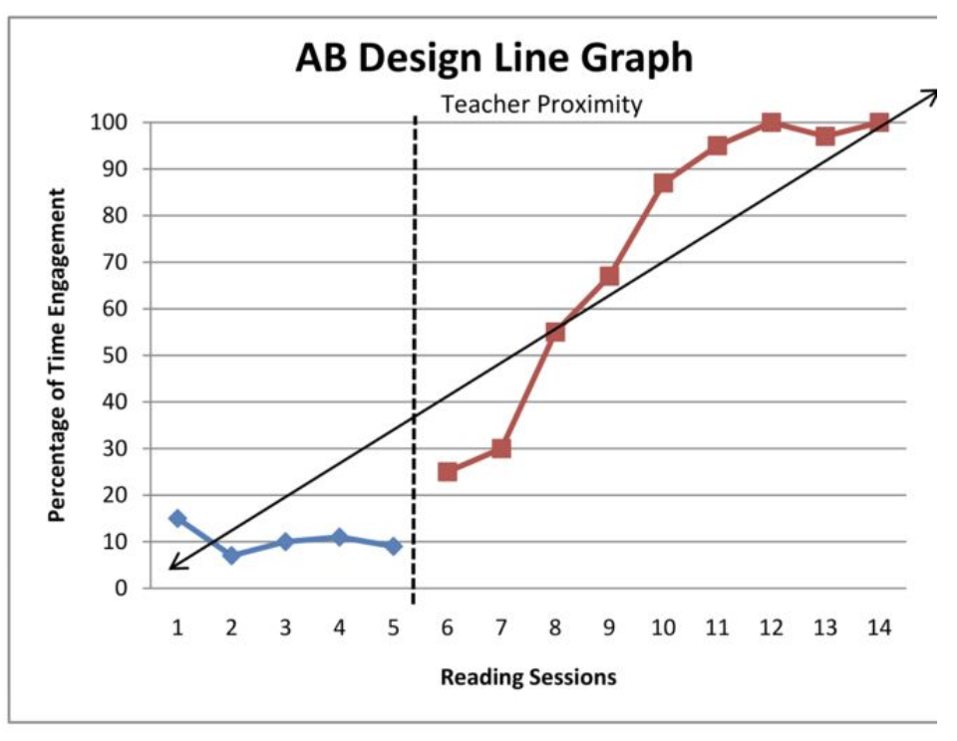

Slide 27
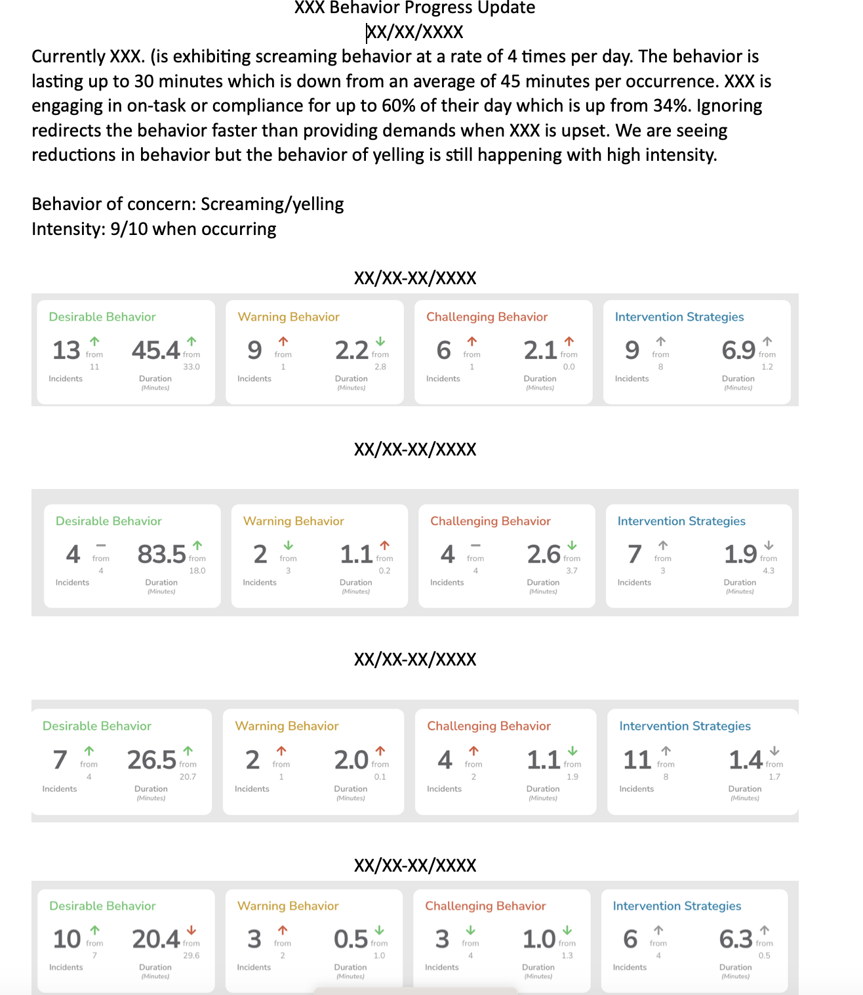

Slide 28
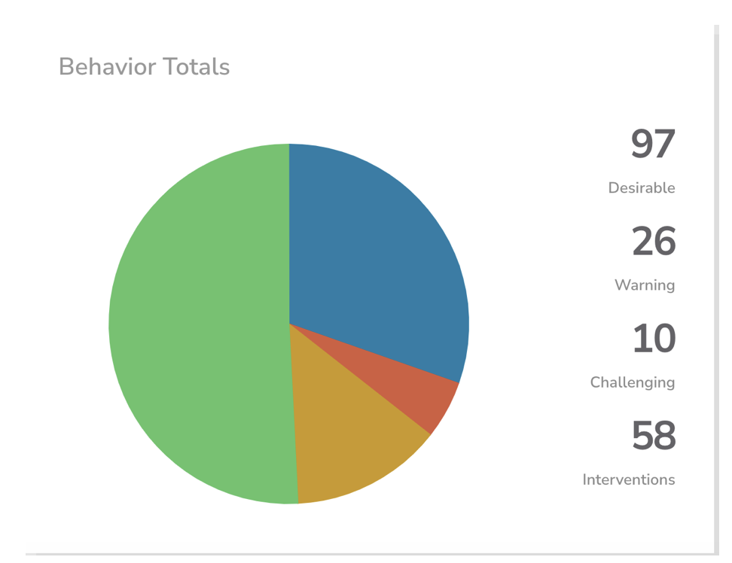
Notes:
More data examples from BEHCA.

Slide 29
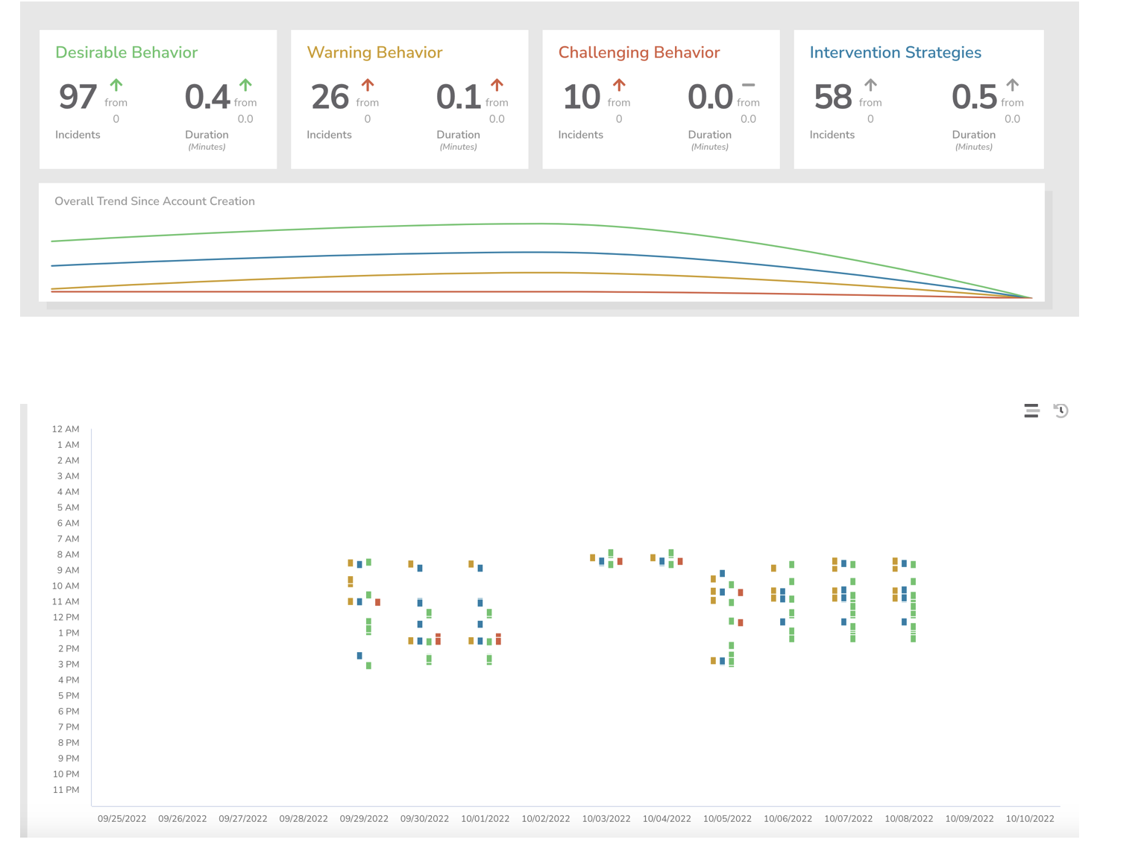

Slide 30
The actual WRITE UP (FBA)
Notes:
Open up your FBA

Slide 31
BIP Time
https://tea.texas.gov/academics/special-student-populations/special-education/behavior-guide-2022.pdf
Pg. 26

Slide 32
When Must we do a BIP?
Legal Requirements related to BIPs involve two situations:
IDEA: BIP is required when a change of placement is contemplated, and the ARD committee determines that the behavior is a manifestation of the disability.
State Law: BIP is required, as necessary, if a school district takes a disciplinary action that constitutes a change of placement under federal law (regardless of manifestation determination).
Thus….
When conduct is a manifestation at the MDR, a BIP is always required.
When conduct is not a manifestation, a BIP is required, as necessary.
If the behavioral need(s) that led to the disciplinary change of placement is not addressed with a BIP, you must address the behavior elsewhere in the IEP with positive behavior supports.

Slide 33
Other Times to consider a bip…
The ARD committee must “In the case of a child whose behavior impedes the child’s learning or that of others, consider the use of positive behavioral interventions and supports, and other strategies, to address that behavior.”
34 C.F.R. § 300.324(a)(2)(i)
A BIP is one of many strategies to address the student’s behavioral concerns.

Slide 34
Who, what, and when of bips?
The law does not require any specific license, certificate, or job title to write a BIP.
BIP is not defined by the law.
Other than situations involving a disciplinary change of placement and MDR, neither Texas, nor federal law requires a BIP.
Texas law does provide that the ARD committee may determine that a BIP is appropriate for a student for whom the committee has developed an IEP.
A BIP is one option to address the behaviors that “impede the child’s learning or that of others.” This is not limited to the behaviors that are caused by student’s disability.
If developed, the BIP must be included in the IEP… therefore the members of the IEP team should agree on its content and the BIP be provided to each staff member responsible for educating the student.

Slide 35
What not to include in a bip?
Anything that requires or prohibits police involvement;
Prohibitions on the use of physical restraints;
Short Term Suspensions or ISS;
Anything that violates the aversive techniques statute; and
Call parent for pick up.
Notes:
If the student has a medical condition that requires the modification of or use of a different restraint technique, that does need to be documented and communicated to staff in
Leashes for elopement
Shock collars

Slide 36
MY BIP 1. Email me at korbin.w@gmail.com, I will send you my fba/bip write up

Slide 37
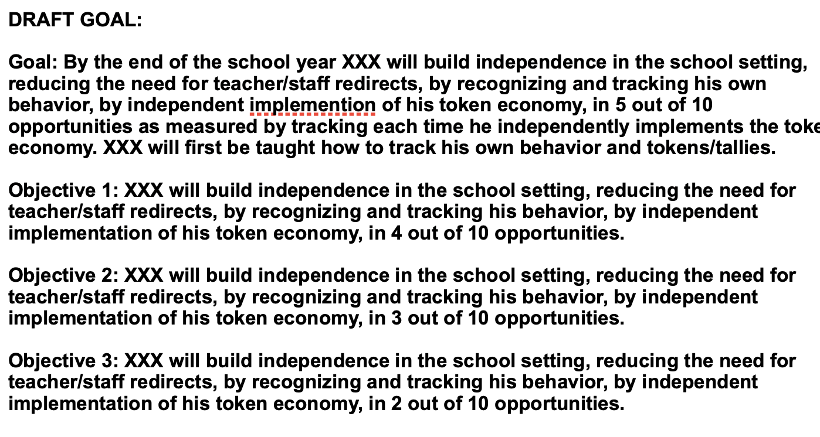
Goals

Slide 39
When must a BIP be reviewed and revised?…
The BIP must be reviewed annually, and
More frequently when:
When the data indicates the plan is not working (do not forget to revise).
Texas law also requires ARD Committees to review and consider any:
Changes in a student’s circumstances that may impact the student’s behavior. (Reflect this is in the ARD meeting deliberations).
The placement of the student in a different educational setting;
An increase or persistence in disciplinary actions taken regarding the student for similar types of behavioral incidents;
A pattern of unexcused absences; or
An unauthorized unsupervised departure from an educational setting; or
The safety of the student or others.

Slide 40
What must be documented in the iep/bip?
Time out may only be used in conjunction with an array of positive behavior intervention strategies and techniques that must be included in the student’s IEP and/or BIP if it is utilized on a recurrent basis to increase or decrease a targeted behavior.
19 T.A.C. § 89.1053(2)
Any other type of removal (student and teacher initiated) from the student’s schedule for behavioral support and instruction.
Example: When student inappropriately responds to peer conflict as demonstrated by _______, either student or teacher may initiate removal to go to ____ to process the events, receive reteaching if necessary, and practice a replacement behavior.

Slide 41
CASE LAW

Slide 42
L.J.B. v. North Rockland Central School District, 83 IDELR 13 (S.D.N.Y. 2023)
The court held that the IEP Team was not required to conduct an FBA and develop a BIP for the student. The court cited the federal regulations that only require “consideration” of a BIP when a student’s behavior impedes learning, but also the state regulations that spelled it out more specifically. They require consideration of a BIP when:
(1) The student exhibits persistent behaviors that impede his or her learning or that of others, despite consistently implemented general school-wide or classroom wide interventions;
(2) The student’s behavior places the student or others at risk of harm or injury;
(3) The [IEP Team] is considering more restrictive programs or placements as a result of the student’s behavior; and/or
(4) As required by [another section of state regulations].

Slide 43
Bruno v. Northside ISD (5th. Cir. 2019)
The Fifth Circuit issues a short opinion that basically says we agree with the decision of the lower court. Northside did nothing wrong. The Court made some key points about FBAs and BIPS:
The “IDEA provides no explicit requirements for FBAs. Rather, industry standards provide the framework for such an evaluation.”
FBAs rely on the premise that all behaviors serve a purpose.”
The purpose of an FBA is to “explore a child’s misbehavior and discover what, if anything, can be done to address it and prevent it from occurring again.”
An FBA is “an educational evaluation under the IDEA.”

Slide 44
Bruno v. Northside ISD (5th. Cir. 2019) continued …
The Court held that the District properly addressed the boy’s behaviors. The ARD committee focused on physical aggression and spitting “because they were most disruptive to his learning and progress when they occurred.” The District charted these behaviors, which allowed it to show that progress was made.
The Court further noted how the school kept the parents in the loop. There was a daily communication log, and a smart phone app to facilitate communication, a daily behavioral chart and a visual schedule.

Slide 45
Lee v. BOE for Prince George’s County, 124 LRP 3463 (D.C. Md. 2024)
The court held that the district was not required to do an FBA or a BIP to address the student’s attendance issues because the parent failed to show that the attendance problems were caused by the student’s disability. The court held that the IEP did not sufficiently address the student’s attendance issues, but absent evidence of a connection with a disability, this was not a denial of FAPE.
I recommend consulting with your attorney before taking this approach. We do not have any case law in the 5th circuit with this same finding.

